Slide 1
Virtual Reality Glove for Hand and Arm Rehabilitation After Stroke (vREHAB)
Clinical Assistant Professor, Stanford University
April 19, 2019

Slide 2
Disclosures
This study was funded by an industry grant from Neofect.

Slide 3
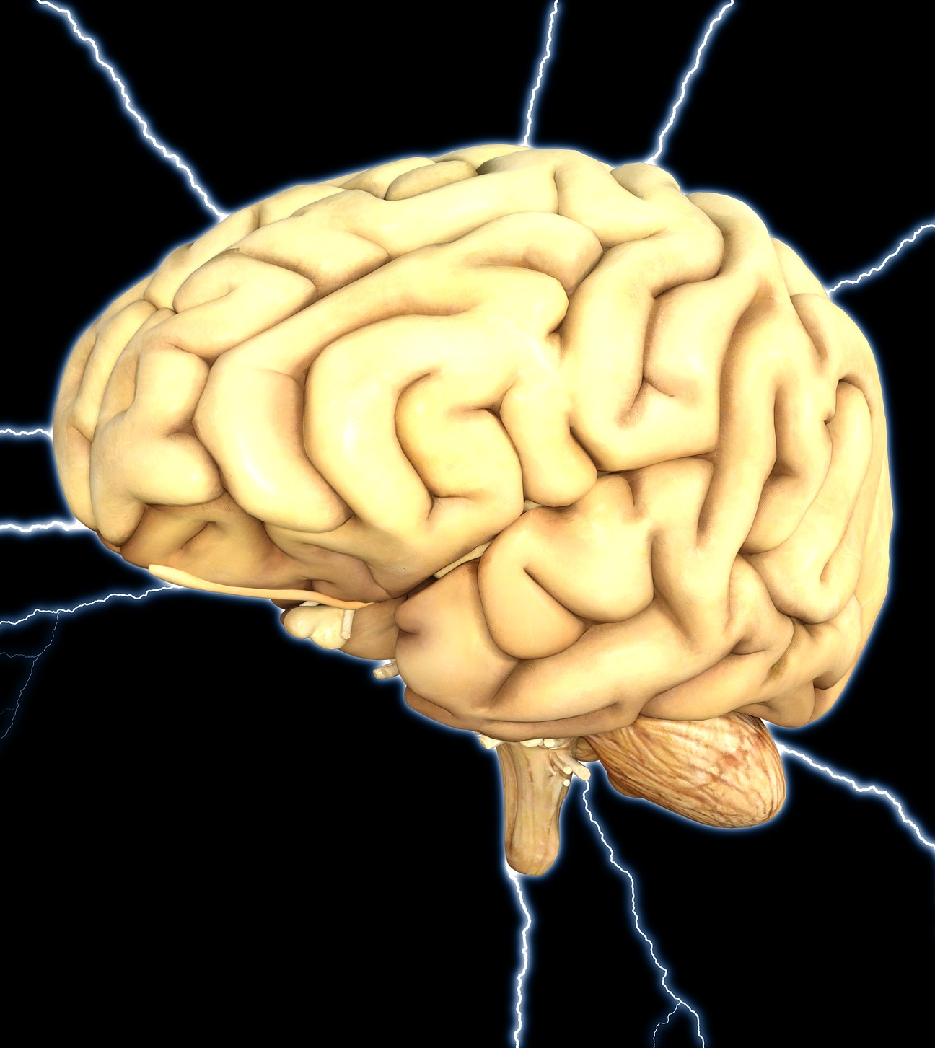
Massed Practice for Stroke Rehab
Repetitive practice of tasks by use of whatever function is present in the affected limbs
Thought to induce neuroplasticity and assist with stroke recovery

Slide 4
Massed Practice for Stroke Rehab
Moderate quality evidence from 2014 Cochrane Review that relatively high dose repetitive task practice leads to beneficial effects after stroke
Greater dose = greater benefit

Slide 5
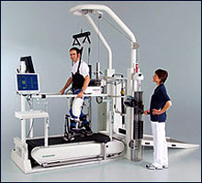
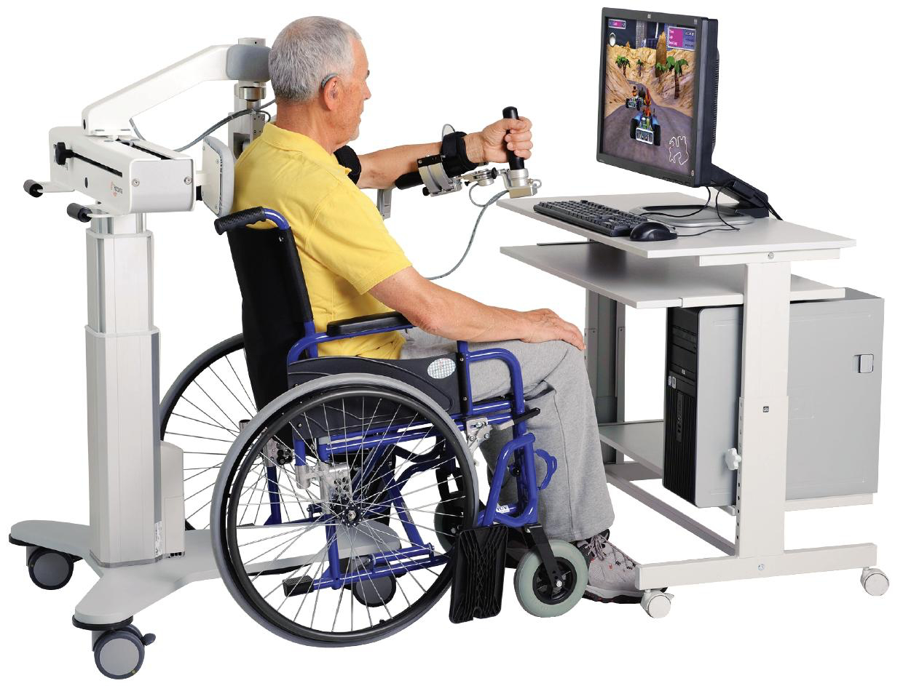
Robotic Devices for Stroke Rehab
Can provide task-specific massed practice training

Slide 6
Downsides of Robotic Rehabilitation
High cost
Must be used in a clinical setting
Require set-up and supervision by a physical or occupational therapist
Patient boredom with repetitive tasks

Slide 7
Virtual Reality for Stroke Rehab
Computer based therapy to simulate real life objects and events
Is often less expensive and more portable than robotic devices
Many VR devices can be used in the home to supplement conventional therapy

Slide 8
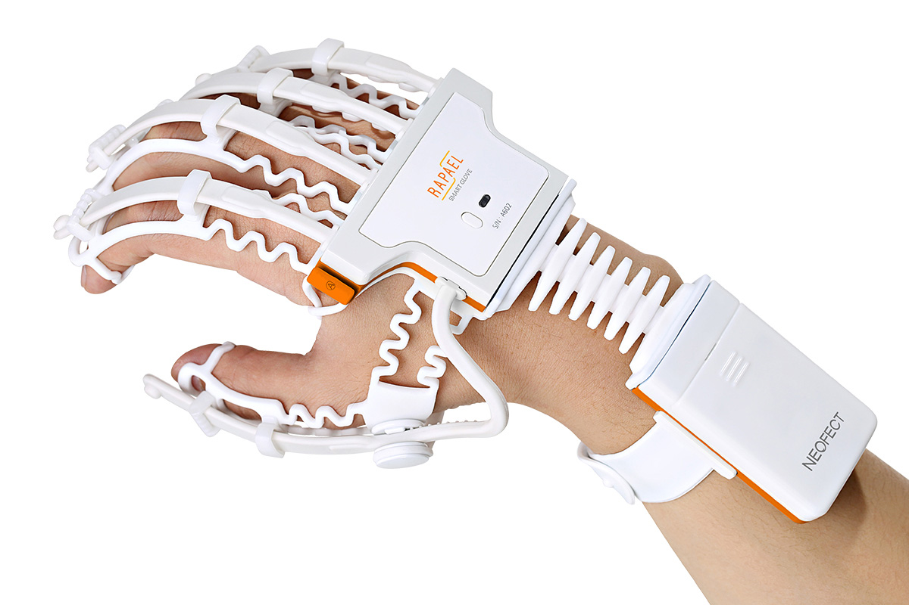
Neofect SmartGlove
Lightweight elastomer glove
Sensors built into the glove detect movement of wrist and individual fingers
Games provide training in the following movements:
  Wrist flexion/extension
  Finger flexion/extension
  Forearm pronation and supination
  Wrist radial and ulnar deviation

Slide 9
Neofect SmartGlove

Slide 10

Neofect Smart Glove

Slide 11
Study Aims
Primary: Assess the feasibility of using the Smart Glove for self-directed home therapy in subacute and chronic stroke patients
Secondary:
  Improvements in motor recovery
  Improvements in upper extremity function
  Self reported measures including ease of use, comfort, effectiveness, and satisfaction with the device

Slide 12
Study Design
20 subjects were enrolled
  More than 3 months out of stroke
  Some unilateral hand weakness
Subjects were instructed to use the device 50 minutes per day for 5 days per week
  Can be split into two 25 minute sessions
Study period was 8 weeks
  Week 0: baseline functional assessment
  Week 2: repeat functional assessment, glove issued
  Week 4: follow-up visit for troubleshooting
  Week 8: functional assessment, completion of self reported measures, data download from device

Slide 13
Functional Assessments: UE Fugl-Meyer
Evaluates and measures recovery in post-stroke hemiplegia
Assesses ADLs and functional mobility
One of the most widely used quantitative meaures of motor impairment
Measures motor function, sensory function, joint range of motion, and joint pain

Slide 14
Functional Assessments: Jebsen Hand Function Test
Assesses ADLS and UE function
Consists of 7 items:
  Writing a short sentence (24 letters, 3rd grade reading difficulty)
  Turning over a 3×5 inch card
  Picking up small common objects
  Simulated feeding
  Stacking checkers
  Picking up large light cans
  Picking up large heavy cans
Scoring done by time, not quality
Lower score = greater function

Slide 15
Results: Feasibility
Average days of use was 25 days during the 42 day study period
Average daily time of use was 24 minutes
6 subjects met the goal of 5d per week of use
3 subjects met the daily time use goal of 50 minutes
Interface was described as easy to use and user-friendly
Most commonly reported barriers to use were poor glove fit and difficulty donning glove

Slide 16
Results: Functional Improvement
Statistically significant decrease in time required to complete Jebsen Taylor Hand Test
  Median of decrease: 32.3 seconds (p=0.016)
  Fine motor JHT testing showed greater improvement than gross JHT
Close to statistically significant increase in UE Fugl-Meyer
  Median of increase: 2.5 points (p=0.087)
  Not clinically significant (MCID = 10 points)

Slide 17
Results: Patient Use
Most subjects favored high frequency use over time-intensive therapy
  60 min per day was too long
No difference in participation between male and female subjects
Subjects >65 years of age demonstrated better use of the device compared to younger subjects

Slide 18
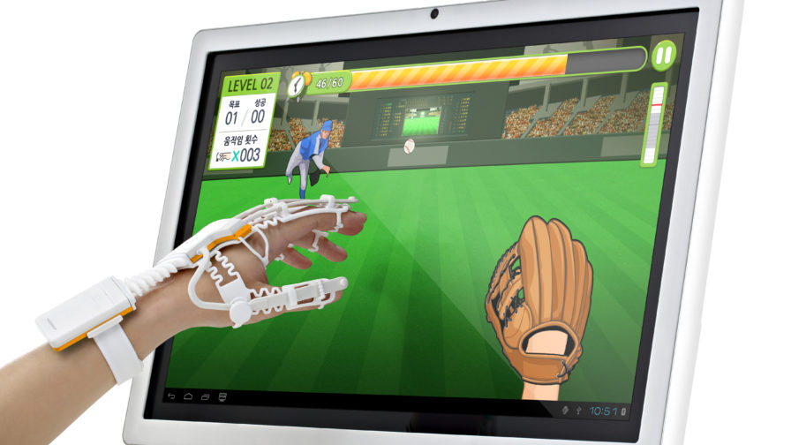
Conclusions
The Smart Glove is a safe, inexpensive, and well adopted device for in-home upper extremity rehabilitation
Improvements in hand function were seen after regular glove use in subacute and chronic stroke patients

Slide 19
Study Limitations
Non-randomized, cohort study
Only 20 participants
No long term follow-up
Population was subacute and chronic stroke subjects who were less likely to demonstrate significant functional improvement

Slide 20
Future Steps
Randomized multi-site study in acute stroke survivors
  Stanford, Intermountain Health, SCVMC, Belgium
Device will be issued within one month of acute stroke
12 week intervention period
  Device use 20-30min per day, 5d per week
Follow-up visit 12 weeks after study period has ended
Patients randomized to usual care group will have the opportunity to use the device for 6 weeks after formal study period has ended.

Slide 21
Have a Patient You Would Like to Refer?
Adam MacLellan, MD
amaclell@stanford.edu
Emily Huang, Research Coordinator
huange@stanford.edu

Slide 22
Thank You!
Clinicians:
  Maarten Lansberg, MD
  Catherine LeGault, MD
  Adam MacLellan, MD
  Julie Muccini, OTRL
  Marion Buckwalter, MD
Research Staff:
  Alay Parikh
  Stephanie Kemp
  Michael Sharp
  Elizabeth Osborn
  Emily Huang

