Slide 1

Scope of Practice and Immunity Issues During COVID-19
Michael Lamb, Esq.
Gordon Ownby, Esq.
Cooperative of American Physicians, Inc.

Slide 2
Educational Objectives
What Are the Basic Elements of a Medical Malpractice Lawsuit?
What Should Be a Physician’s Concerns on Scope of Practice during the Pandemic?
Does COVID-19 Require Extra Informed Consent?
What Are the Federal and State Provisions for Healthcare Immunity During the Pandemic?

Slide 3

Elements of a Lawsuit
Duty
Breach in the Standard of Care
Injury
Connection Between Injury and Breach

Slide 4
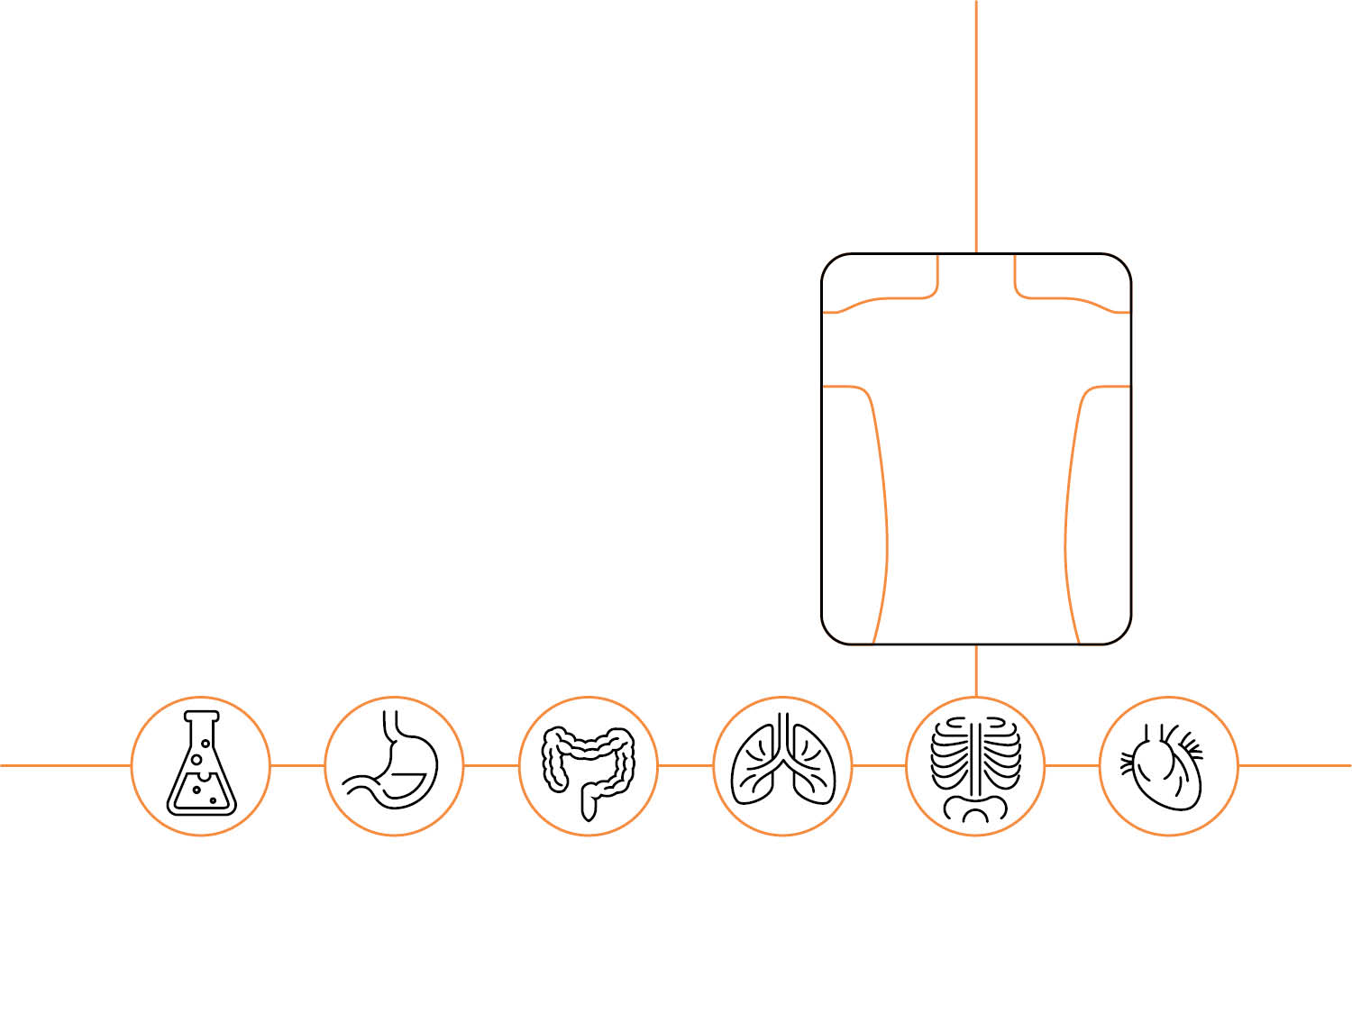
Scope of Practice
Education, Training & Experience
Residency or Applicable Subspecialty?
Would Expansion Be Considered Reckless?
Comfort Level - Reasonable or Unreasonable?
Medical Professional Liability Coverage

Slide 5

Informed Consent
It’s Not the Document, It’s the Discussion
Most Document Templates Are Wide-Ranging
Custom & Practice Testimony Acceptable
Additional Note Useful During the Emergency

Slide 6
Informed Consent
“My physician has explained the risks of possible Corona Virus exposure. I understand and accept the risks and have chosen to proceed with the surgery.”

Slide 7

Federal & State Immunity
Federal CARES Act
COVID-19 Healthcare Provider Protection Act
California Good Samaritan Law
California State of Emergency

Slide 8
Federal CARES Act
Section 3215. Limitation on liability for volunteer health care professionals during COVID-19 emergency response. Pre-empts State law to provide liability protection (immunity) to any volunteer health professional for harm caused by simple negligence in providing in good faith treatment in response to and during the COVID-19 public health emergency. The professional must be acting within the scope of his or her license, not acting in an intentional or willful and wanton manner, and not be under the influence of alcohol or drugs.

Slide 9
COVID-19 Healthcare Provider
Protection Act of 2020
Congress Finds:
“In order to assure adequate provision of healthcare services in interstate commerce during the course of this pandemic, and to incentivize healthcare providers to continue offering such services wherever they may be located, it is necessary to provide liability protections to such providers, protecting them from claims or lawsuits arising out of, resulting from, or related to the provision of healthcare services.”

Slide 10
COVID-19 Healthcare Provider
Protection Act of 2020
Section 4(a): “Notwithstanding any other provision of law to the contrary, no healthcare provider shall be liable for any harm, damage, breach, or a tort caused by, arising out of, relating to, or resulting form any act of omission of the healthcare provider in arranging for or providing healthcare services.”

Slide 11
COVID-19 Healthcare Provider
Protection Act of 2020
Exception:
“Section 4(a) shall not apply if a harm, damage, breach, or tort resulting from or related to arranging or providing healthcare services is shown by clear and convincing evidence to be the result of intentional criminal conduct, intentional infliction of harm, willful misconduct, or gross negligence, provided, however, that acts, omissions, or decisions resulting from a resource or staffing shortage shall not be considered to be intentional criminal conduct, intentional infliction of harm, willful misconduct, or gross negligence.”

Slide 12
COVID-19 Healthcare Provider
Protection Act of 2020
HR 7059 Introduced on May 29, 2020
Sponsors: Phil Roe (R-TN) & Lou Correa (D-CA)
Services Must Be Within Scope of Licensure, Notwithstanding Scope of Practice
Good Prospect for Passage
https://actnow.io/WqPZnbe

Slide 13

State Good Samaritan Law
H&S Code Section 1799.102:
No person who in good faith, and not for compensation, renders emergency medical or non-medical care at the scene of an emergency shall be liable for any civil damages resulting from any act or omission. The scene of an emergency
shall not include emergency departments and other
places where medical
care is usually offered.

Slide 14
California State of Emergency
Declared by Gov. Newsom on March 4, 2020
Immunity Applies to All Healthcare Providers, Not Just Volunteers

Slide 15
California State of Emergency
Gov. Code Section 8659:
“Any physician or surgeon (whether licensed in this state or any other state), hospital, pharmacist, respiratory care practitioner, nurse, or dentist who renders services during any emergency at the express or implied request of any responsible state or local official or agency shall have no liability for any injuries sustained by any person by reason of those services, regardless of how or under what circumstances or by what cause those injuries are sustained; provided, however, that the immunity herein granted shall not apply in the event of a willful act or omission.”

Slide 16

Do Good. Stay Well.

