Slide 1
Community-based resources
for patients with chronic pain

Slide 2
Paradigm Shift #1
Chronic pain, regardless of pathophysiology or causation, is a
chronic, non-infectious disease.
Our goal is to minimize the impact of that disease to allow people to lead comfortable, productive lives.

Slide 3
Case Study
Hypothetical case study: This is a 45 year old woman who is moderately obese. She complains of persistent low back pain with radiation down the left leg as far as the knee and intermittent right-sided back pain into the right buttock. Pain has been present for over 6 months without obvious precipitating cause, although she connects onset of pain with a change in her work situation, that required her to stand in front of a counter with a plexiglass shield in front of her in order to serve customers. She was previously allowed to move around freely and to sit at times during the work day. She denies any previous history of low back pain and denies any difficulty with bowel or bladder symptoms. The patient has had a total of 12 sessions of physical therapy without significant benefit. MRI of the lumbar spine reveals age-appropriate degenerative findings without specific localizing abnormalities. Worker’s compensation has denied authorization for a trial of acupuncture and has made arrangement for a QME to consider permanent and stationary status. The pain is severe enough to interfere with sleep. The patient is requesting “pain medicine.”

Slide 4
Paradigm Shift #2
The patient is in charge

Slide 5
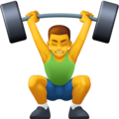

The patient as participant
You get out what you put in.
Also known as:
No pain, no gain

Slide 6
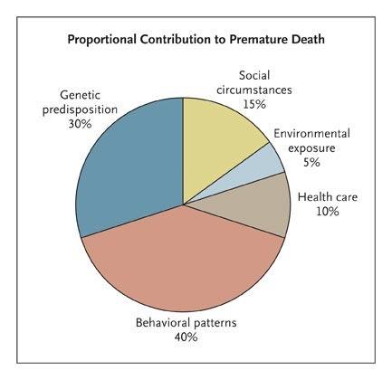
Paradigm Shift #3
The health care system is not the only determinant of health.
Social determinants of health: NEJM 9/20/07, 357:1221-1228, Steven Schroeder

Slide 7
Behavioral Change
It may be simple, but it isn’t easy.
🤦

Slide 8

There is no magic wand.

Slide 9

Money, Money, Money, Money, Money

Slide 10
Paradigm Shift #4
Here’s an idea:
😒 😩 😣 😱 😍
Systems that provide medical care are NOT the only systems that provide health services.

Slide 11


A major service that we can offer is guidance toward resources that reduce the burden of chronic pain.

Slide 12

Goals
“reduce the burden”
NOT
“cure”

Slide 13
Institute for Lifestyle Medicine www.instituteoflifestylemedicine.org
The Institute of Lifestyle Medicine (ILM) was founded in 2007 at Spaulding Rehabilitation Hospital and Harvard Medical School to reduce lifestyle-related death and disease in society through clinician-directed interventions with patients.

Slide 14
Institute for Lifestyle Medicine www.instituteoflifestylemedicine.org
The Institue for Lifestyle Medicine offers the following services:
Training for health professionals wishing to improve their personal lifestyle choices so they can be more effective role models for their patients.
Lifestyle Medicine CME courses including Lifestyle Medicine: Tools for Promoting Healthy Change and Active Lives: Transforming Ourselves and Our Patients (Registration and information available July 2020).
Online Lifestyle Medicine CME courses through Harvard Medical School.
Consulting services to corporations, hospitals, medical practices, health & wellness providers, and fitness facilities.
Culinary Medicine programs.

Slide 15
Lifestyle Issues
Weight
Stretching
Exercise
Depression/anxiety
Drug/alcohol Use or Addiction

Slide 16
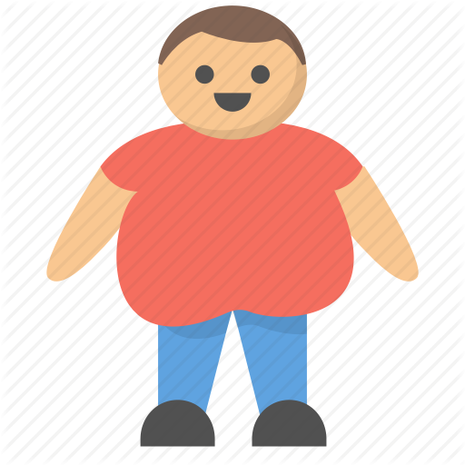
Weight
“But the doctor didn’t SAY anything!”

Slide 17

Words of Wisdom
Weight reduction REQUIRES dietary change.

Slide 18

Words of Wisdom
Calorie reduction reduces weight.

Slide 19

Words of Wisdom
Exercise can maintain weight loss,
but DOES NOT create it.

Slide 20

Words of Wisdom
THERE IS NO EASY DIETING

Slide 21
Resources
General medical insurance
Weight Watchers
My Fitness Pal
+ many, many others (just try to avoid crazy)

Slide 22
Stretching
YouTube.com

Slide 23
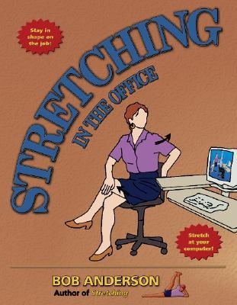
Stretching

Slide 24
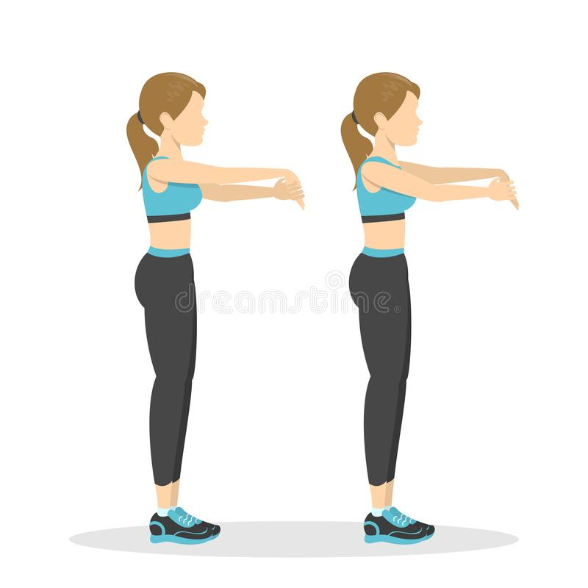
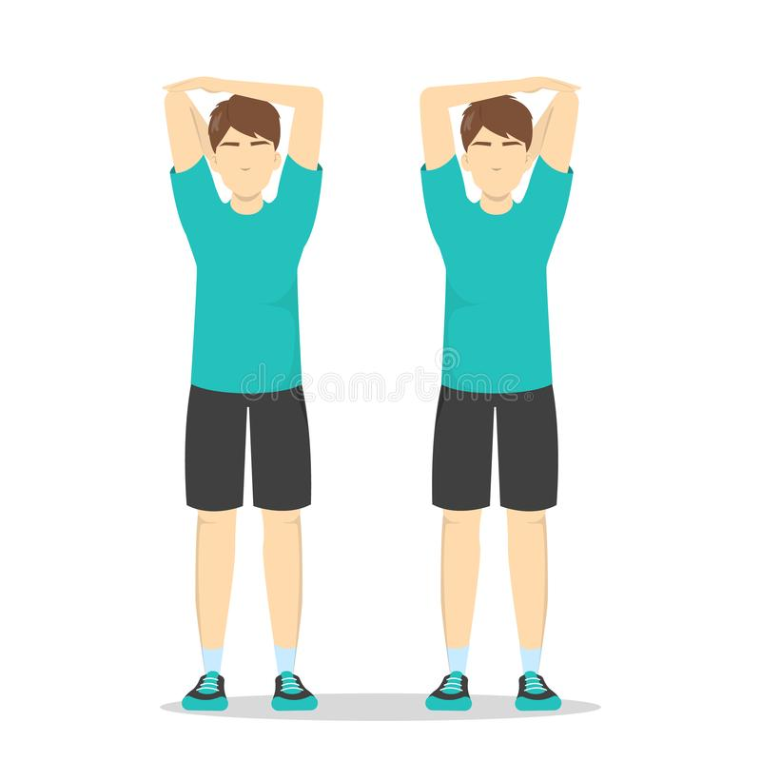
Stretching
Office Stretches
https://www.lifehack.org/articles/productivity/15-simple-and-quick-office-stretches-boost-work-efficiency.html

Slide 25
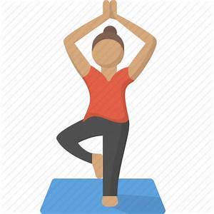
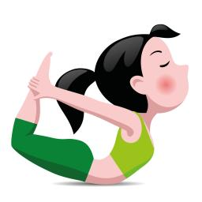
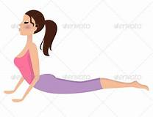
Stretching
Yoga

Slide 26

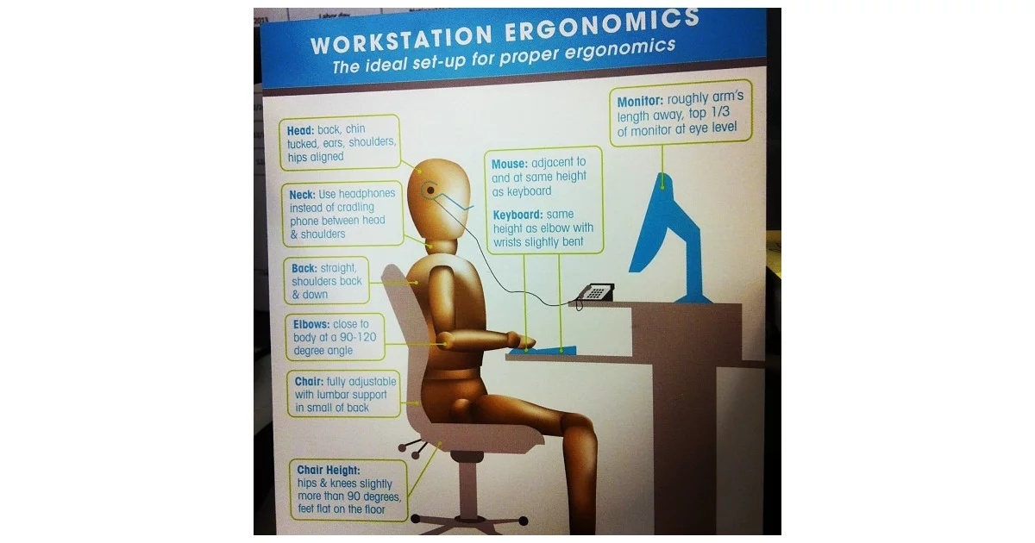
Office Ergonomics
Education, Education, Education, Education, Education, Education,

Slide 27
Home Exercise
YouTube.com

Slide 28
EXERCISE
Walking Swimming Biking Dancing Zumba Yoga
Gardening Housework Scuba Karate Baseball Golf
Running Basketball Tennis Badminton Volleyball Bowling
Hiking Ping Pong Hockey Football Frisbee Catch
Fishing Trampolining Squash Handball Hunting Skating
Kite flying Hang gliding Rugby Pickleball Martial arts Sailing
Sledding Windsurfing Skiing Paintball Laser tag Polo
Wrestling Weightlifting Tag Rowing Climbing Diving
Snorkeliing Handball Archery Skateboard Kickball Soccer

Slide 29
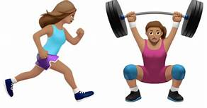

EXERCISE
Practical tips:
1. Local recreational centers often have free or low-cost classes and adult teams.
Meetups.com
Sierra Club: Runs regular hiking groups at all levels of conditioning.
4. Silver Sneakers: Some Medicare Plans include “Silver Sneaker” Gym Memberships, one of many nation-wide fitness programs that have partnerships with Medicare Insurance providers.

Slide 30

DEPRESSION AND Anxiety
Life events
Depression Pain
Injury

Slide 31

STRESS
Chronic Stress Chronic Pain Chronic Depression

Slide 32

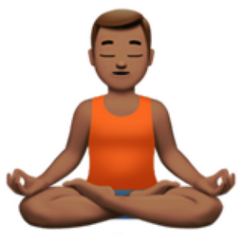

STRESS/PAIN MANAGEMENT
Kaiser Behavioral Health
Stress Management:
Meditation:
Sleep:

Slide 33

ACUPUNCTURE
Community Acupuncture defines and supports a mode of direct delivery of inexpensive care for people of ordinary incomes regardless of insurance coverage.

Slide 34

ACUPUNCTURE
From the Oakland Acupuncture Project:
The purpose of Oakland Acupuncture Project is to make Chinese Medicine accessible by providing affordable community-centered health care. All acupuncture treatments are individualized to meet your needs, and are performed in a quiet community space.
We charge on a sliding scale: $20-40 for follow up visits. You decide what you can afford. We will NEVER make you prove your income level. We want you to come often enough to really get better, and the sliding scale is our way of helping you make that commitment. First time appointments are a flat rate of $40.

Slide 35

ACUPUNCTURE
To learn more about community acupuncture and to find a directory of clinics, visit POCA (The People’s Organization of Community Acupuncture.)
https://www.pocacoop.com/

Slide 36

SUBSTANCE USE DISORDER
Need I say more?

Slide 37


SUBSTANCE USE DISORDER
I guess I did need to say more.

Slide 38


SUBSTANCE USE DISORDER
Rehab Is A Very Expensive Program Where You Go To Learn That 12-Step Programs Are Free.

Slide 39

ALCOHOLICS ANONYMOUS (AA)
NARCOTICS ANONYMOUS (NA)
Narcotics Anonymous Alcoholics Anonymous
NA.org AA.org
Narcotics Anonymous is a "nonprofit fellowship of men and women for whom drugs had become a major problem"
Alcoholics Anonymous is an international fellowship of men and women who have had a drinking problem. It is nonprofessional, self-supporting, multiracial, apolitical, and available almost everywhere. There are no age or education requirements. Membership is open to anyone who wants to do something about his or her drinking problem.

Slide 40
NARCOTICS ANONYMOUS
Suboxone
Medication use is a member’s personal decision, and is an outside issue for NA groups. This piece is intended for groups as they consider this issue. It does not address members’ personal decisions, nor does it try to change members’ opinions about medication.

Slide 41

SUMMARY
Weight
Stretching
Exercise
Depression/Anxiety
Drug/Alcohol Addiction
At least make the suggestion!

