Slide 1
Managing Patients with Substance Use Disorder, Pain and Co-Occurring Mental Illness
Ricardo Restrepo, MD., MPH
Substance Abuse Treatment Program-SATP/Buprenorphine Clinic Medical Director
Associate Clinical Professor at University of California, Irvine
Department of Psychiatry and Human Behavior
California Society of Physical Medicine and Rehabilitation
Saturday April 25th, 2020
Long Beach, CA

Slide 2
California Society of Physical Medicine and Rehabilitation
Disclosure information
Ricardo Restrepo, MD., MPH
No disclosures
2

Slide 3
Outline
Prevalence of Co-Occurring Psychiatric Disorder in Chronic Pain Patients
The Impact of Psychiatric Co-Morbidity on Chronic Pain
Assessment of Chronic Pain Patients with Co-Occurring Psychiatric Disorder
Treating Co-Occurring Psychiatric Disorders in Chronic Pain Patients
Conclusions
3

Slide 4
CASE
Patient is a 63 y.old, Caucasian, professional, female with incisional pain from prior left knee replacement for the past two years.
Would like some specific advice on tapering the opioids. She is o MS Contin and Percocet. She says she used in the past IR Morphine, but has come off of that without worsening of the pain which the patient is agreeable to do. Also advise on benzodiazepines. Pt reports that PCP prescribed this last medication for her anxiety/stress.
Change doctors ; this is the first visit with you
On exam: Mild to moderate pain on extension of the knee, then you noticed sweaty, mild anxiety and she reported some abdominal cramps
Had a bad experience with PT
Tried acetaminophen, ibuprofen, and cyclobenzaprine without benefit in the past

Slide 5
Co-Occurring Mental Illness & Chronic Pain
CONDITION | Current Incidence in Chronic Patients | Incidence in the General Population
Depression | 45% | 5%
Anxiety Disorders | 25% | 3% to 8%
Personality Disorders | 51% | 10% to 18%
PTSD | 2% civilian population 49% veteran population | 1% general population 20% combat veterans 3.5 to 15% in civiloans with trauma
SUD | 15% to 28% | 10%
Somatoform Disorders | 97% in chronic low back pain patients in inpatient rehab programs | unknown

Slide 6
Psychiatric Co-Morbidity & Chronic Pain Summary- Prevalence of Co-Occurring Disorders
The incidence of co occurring psychiatric disorders is 2 to 3 times higher in chronic pain patients than in the general population
The most common co-occurring disorders are depression, anxiety disorders and substance use disorders
The incidence of PTSD is very high in combat veterans with chronic pain

Slide 7
Is there a relationship between chronic pain and depression?
Depression is the most common co-occurring psychiatric disorder in patients with chronic pain, occurring in 45% of such patients (Cheatle 2006).
Among patients with Major Depressive Disorder (MDD), a significantly higher proportion reported chronic (i.e., non-disabling or disabling) pain than those without MDD (66% versus 43%, respectively).
Disabling chronic pain was present in 41%of those with MDD versus 10% of those without MDD.

Slide 8
How are depressed chronic pain patients different from non-depressed pain patients?
Compared to pain patients without MDD, patients with co-morbid MDD and disabling chronic pain had the following characteristics:
Significantly poorer quality of life
Greater somatic symptom severity
a higher prevalence of panic disorder
A six-fold greater prevalence of anxiety
Arnow BA, et al., Psychosomatic Medicine 2006;68:262-268

Slide 9
Is there a difference in treatment response in chronic pain patients with Co-Occurring Mental Illness?
• Poor adherence to treatment
• Worse satisfaction with treatment
• Higher likelihood for relapse
• Less chance for function improvement
Bair MJ, et al., Archives Internal Medicine 2003,163(20):2433-2445

Slide 10
How common are co-occurring depression and anxiety disorders in chronic pain patients ?
All depressed pain patients should be screened for an anxiety disorder
There is a16% prevalence of co-occurring disorders
Most anxiety disorders are present before pain onset
Most depressive disorders appear after onset of pain
Psychiatric comorbidity is associated with increased pain intensity
Knaster P, et al., General Hospital Psychiatry 2012, 34:46-52

Slide 11
How common is chronic pain and PTSD?
PTSD is relatively infrequent in civilian patients with chronic pain, averaging about 2%
The incidence in combat veterans can be as high as 49%. These patients often present with depression and other anxiety disorders
Anticipate substance use disorders in these patients

Slide 12
Does long-term treatment with opioids increase the risk for SUD?
General population studies suggest up to 35% of individuals receiving long-term opioids for chronic pain meet criteria for opioid use disorder
Much higher than previous estimates
(J Addictive Disease July 2011)
Returning veterans may be at particular risk for pain syndromes with co-occurring SUD and other psychiatric disorders, including PTSD and Traumatic Brain Injury (TBI)

Slide 13
Mental Disorders Most Commonly Seen when you work with SUD patients
Depression
Bipolar depression
Panic disorder
GAD
Social Anxiety
PTSD
ADHD

Slide 14
Assessment for Psychiatric Disorders in patients with chronic pain
The initial assessment of all chronic pain patients should include a review of psychiatric symptoms and previous treatment, and a mental status exam
Be sure to include questions regarding:
-Depression/anxiety
-Substance use h/x
-Early childhood abuse & current domestic violence
-PTSD
-Suicidal ideation
-Medications from multiple providers
-Any litigation or compensation involved?
Assessment should include:
‐ Urine toxicology
-Review of state Prescription Drug Monitoring Program data
• If the diagnosis is unclear, refer for a psychiatric evaluation

Slide 15
Critical First Steps in Patient Assessment
Screen for depression with suicidal ideation and plans for self-harm
‐ Suicidal patients should be referred for psychiatric evaluation and/or hospitalization
Screen for SUD (alcohol or any substance)
‐ Patients addicted to alcohol or sedatives may require inpatient detoxification before pain management can proceed
Patients abusing opioids may require detoxification or stabilization on methadone or buprenorphine

Slide 16
CASE
She asked about coming off of benzos but wants to be sure first b/c of seizure d/o history. When you get the chart and review different procedures, including EEG, EKG and other labs , all were normal. Pt states taking now a medication for depression/anxiety.
Pt agrees with taper and explore different modalities of treatment including CBT.
Pt now is with:
    MS Contin (Morphine SO4) 2018. ----30 mg tid
    Percocet (Oxycodone 5mg /Acetaminophen 325mg) 2018-----2 tablets every 6 hours
    Gabapentin 2019------300 mg tid
    Clonazepam 2018------0.5 mg bid
    Venlafaxine 2020------375 mg qam

Slide 17
How to Rule Out Substance- Induced Psychiatric Disorders
Chronic or acute use of substances can mimic symptoms of many psychiatric disorders.
  Acute intoxication: mood symptoms
  Withdrawal: anxiety and Mood disorders
  Chronic Use: delirium, cognitive changes

Slide 18
How to Rule Out Substance- Induced Psychiatric Disorders
Symptoms occur during or within 30 days of intoxication or withdrawal
Symptoms maybe reasonably assumed to be substance-induced – examples:
‐ Alcohol: depression, anxiety, hallucinations
‐ Stimulants: depression, mania, paranoid
psychosis
‐ Psychedelics: psychosis, somatic delusions
‐ Marijuana: psychosis
• Symptoms remit with sobriety

Slide 19
What Criteria Suggest that substance-induced psychiatric disorders are less likely
Symptoms were present prior to substance use
Symptoms are present during extended periods of sobriety (minimum 3 months)
There is a family history of a similar disorder
If symptoms are diagnosed while using the substance, or immediately following detoxification, reassess after 3-4 weeks sobriety

Slide 20
How to make the diagnosis of Substance-induced psychiatric disorders
Do not attempt to confirm the diagnosis while patient is intoxicated or within 3-4 weeks of substance use or detoxification treatment
Verify drug free state with laboratory tests and assess psychiatric status when sober
Obtain a careful longitudinal history tracking both substance use and psychiatric symptoms – track parallel symptom courses
Confirm history with relatives
Review family history for psychiatric disorders

Slide 21
Completing the psychiatric assessment
If you are able to rule out a substance-induced psychiatric disorder, proceed on the assumption that current symptoms reflect an independent psychiatric disorder and that psychiatric treatment will be required
If symptoms are substance induced, treatment for SUD must be part of the treatment plan
A repeat psychiatric assessment should be part of the annual treatment plan review for all chronic pain patients

Slide 22
General Principles: How to manage psychiatric disorders in chronic pain
The basis for the successful management of chronic pain and co-occurring psychiatric disorders is a Biopsychosocial Treatment approach.
If screening identifies the presence of an active substance use disorder and/or any substance- induced psychiatric disorder, patients must first be referred for detoxification (if required) and ongoing addiction treatment must be integrated into the ongoing chronic pain management program

Slide 23
What is Biopsychosocial Treatment
The biopsychosocial model for chronic pain management includes:
‐ Evidence-based pharmacotherapy for both chronic pain and any co-occurring psychiatric disorders
‐ Cognitive-behavioral therapy (CBT) – this should address pain issues and any relevant psychiatric symptoms, including substance use disorders
‐ A graded exercise program

Slide 24
What are the guidelines for pharmacotherapy of psychiatric disorders in chronic pain patients
Begin with Chronic Pain Self Management
Add CBT and a Graded Exercise Program
In most cases, standard psychiatric medications for depression, anxiety disorders and PTSD can be used
There is little research available to guide medication choices in chronic pain patients
Avoid medications with an abuse potential
Side effect profile can guide medication choice
Monitor for medication compliance

Slide 25
What is Chronic Pain Self Management
Treatment should always begin with a Chronic Pain Self-Management Program:
Patient education on the physiological mechanisms underlying their pain and the efficacy of recommended treatments
Patients must take responsibility for compliance with any recommended pharmacotherapy. This includes medications for pain and any psychiatric disorder
Patients must take responsibility for implementation of any graded exercise program

Slide 26
Early implementation of CBT in chronic pain treament
Patients who complete a pain program based on biopsychosocial/CBT model demonstrate:
Improve return to work
Pain reduction
Increased activity
Reduced medication use
Benefits were maintained at 5 year follow up
McCraken IM, Turk DC, 2002, Spine 27:2564-2573

Slide 27
Best Practice to Treat Patients with psychiatric disorders and chronic pain
Informed consent
Regular UDS
Checking CURES
Shorter supplies of buprenorphine
See patient more frequently

Slide 28
CASE
Your differential diagnosis:
- r/out OUD
- r/out MDD recurrent, moderate
- r/out Anxiety disorder
- r/out Pseudo-seizure
- h/x of knee replacement
Treatment plan possibilities and steps to be considered:
-Taper, Psych, Rehab, Non opioid, Naloxone, Utox, PDMP, Medical Comorbidities, labs, ROI to contact family.
Anything else?

Slide 29
What does not work
Confrontation
Insight-oriented psychotherapy
Generic CBT
Intensive group treatment
Kicking people out of treatment

Slide 30
How to manage the pharmacotherapy of psychiatric disorders in chronic pain patients
Begin with non-abuseable medications - the SSRI’s are a good choice to treat BOTH depression and anxiety
Adequate doses for an adequate time (6 to 8 weeks)
If no response consider SNRI’s, or dual action agents
CBT will improve the response to medications
Benzodiazepines have no role as a primary treatment for
depression or PTSD
Benzodiazepines can be used with caution, and short term, for some anxiety disorders if the patient has not responded to CBT and/or antidepressant medications and has no history of abuse of benzodiazepines

Slide 31
Benzodiazepines + Opioids
Benzodiazepines (BZs) are the most frequently cited co-intoxicants involved in opioid-related morbidity and mortality.
In 2010, the CDC reported 16,651 pharmaceutical opioid-related overdose deaths based on death certificate data- almost one of every three opioid-related deaths in 2010 also involved BZs
On August 31, 2016 FDA issued a drug-safety communication about risks when opioid pain or cough meds are combined with BZs.
(Hwang et al., 2016; Jones, Mack & Paulozzi, 2013; DEA 2013)

Slide 32
Medication Management
Ambivalence is common re: use of meds in patients with SUDs
When to initiate pharmacotherapy when diagnosis is unclear?
  With psychosis, depression, moderate to severe or mania, treat sooner.
  Strategies include:
    Verbalize clear expectations
    Assume potential misuse and drug interactions
    Schedule frequent follow ups

Slide 33
Pharmacotherapy recommendations for psychiatric disorders in patients with chronic pain
Depression–SSRIs;Venlafaxine,Duloxetine,, Bupropion
Generalized AnxietyDisorder–SSRIs; Buspirone, Duloxetine, Escitalopram
Panic Disorder–SSRIs
Social Anxiety–Paroxetine
PTSD–SSRIs,Venlafaxine vER & Prazosin
Bipolar Disorder – Valproate

Slide 34
What are the risks for SUD in depressed patients on chronic opioid therapy?
Patients with moderate to severe depression are 1.8 and 2.4 times more likely, respectively, to misuse opioid medications to relieve these symptoms
Such patients will benefit from pharmacotherapy with antidepressants
There are no clear guidelines for what medication, though consideration should be given to duloxetine or venlafaxine because their efficacy in chronic pain management
Grattan A, et al., 2012, Annals Family Med 10(4):304-311
Cheatle MD, Gallagher RM, 2006,Current Psych Reports 8:371-376

Slide 35
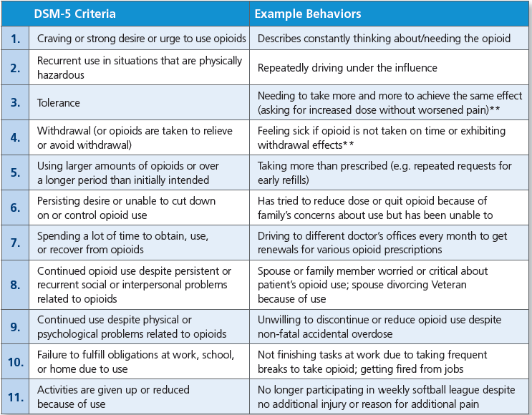
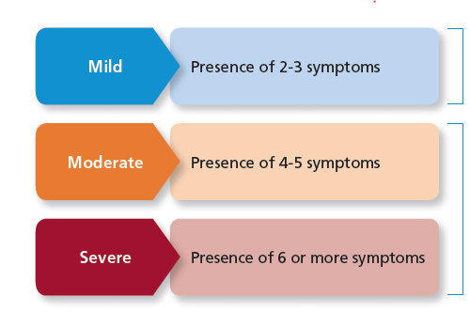
DSM-5 Diagnostic Criteria for OUD

Slide 36
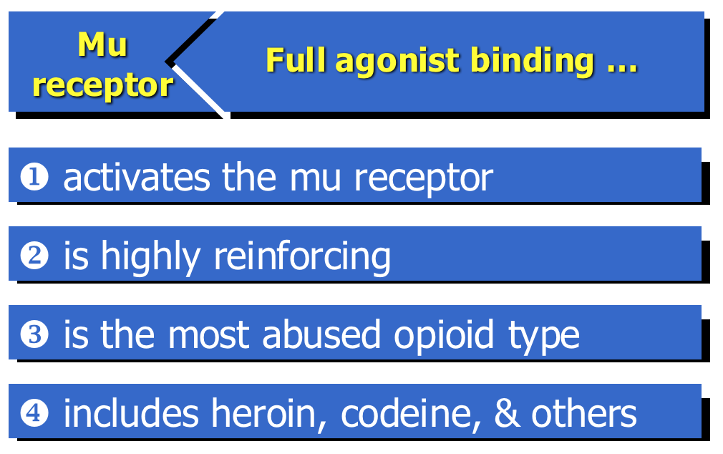
Full Opioid Agonist

Slide 37
Full Opioid Agonist: Methadone
Although a full agonist, methadone can help to decrease cravings
  No immediate gratification reward, gradual build-up
  Long-lasting: half life of 24-55 hours
  High affinity for the opioid receptor and occupies the space
Can be used in both detox and maintenance settings
  Detox: 20-40mg daily
  Maintenance: 80-120mg daily
Can only be given for treatment of opioid use disorder at designated methadone opioid treatment programs (OTP)
  Daily attendance; can be cumbersome
Concerns:
  Potential for fatal overdose
  Increased risk of prolonged QTc
    Screen patients for family history, known cardiac disease or syncopal episodes, on multiple drugs that may prolong QTc
    EKG monitoring for at-risk patients and if methadone dose >100mg daily

Slide 38

Partial Opioid Agonist: Buprenorphine
Helps to decrease cravings, intensity and frequency, without euphoria
High affinity for $μ$-opioid receptors and is slow to dissociate
Patient must be in mild-moderate opioid withdrawal (or completely abstinent) prior to buprenorphine induction
  Abstinent 16-36 hours before induction
    16 hours for short-acting opioids (heroin)
    24 hours for extended release opioid medications
Maintenance dosing is usually 8-16mg daily.
  Some take every other day or 3x/week
No recommended time limit for treatment: can be used for detox as well as maintenance.

Slide 39
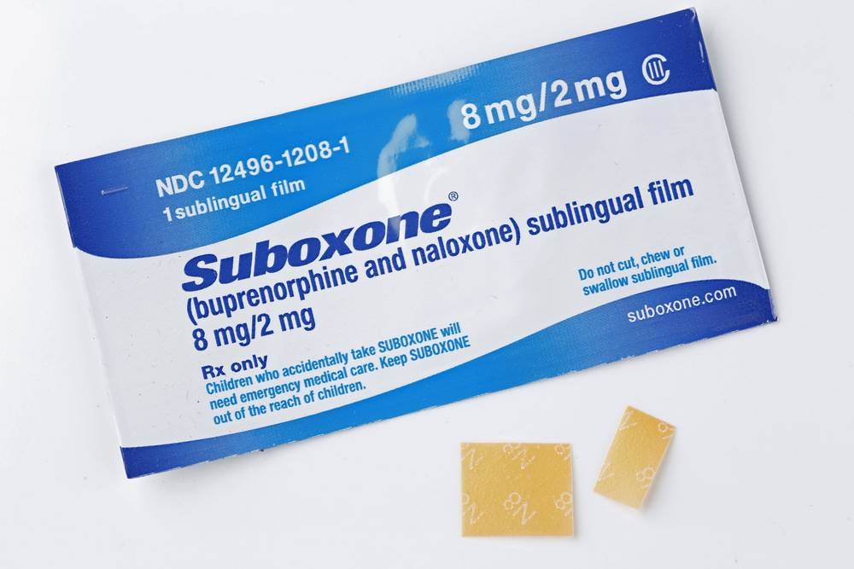

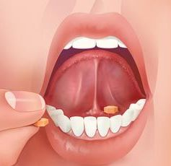
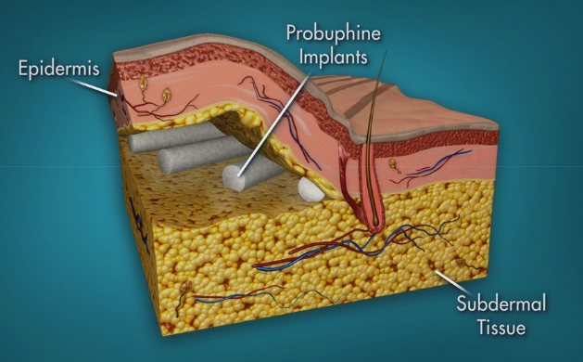
Partial Opioid Agonist: Buprenorphine
  Sublingual films
    Buprenorphine/naloxone (Suboxone)
  Buccal films
    Buprenorphine/naloxone (Bunavail)
  Sublingual tabs
    Buprenorphine (Subutex)
    Buprenorphine/naloxone (Zubsolv and generic equivalents)
  Subdermal rod implants
    Buprenorphine (Probuphine)
  Subcutaneous
    Buprenorphine/naloxone (Sublocade)

Slide 40
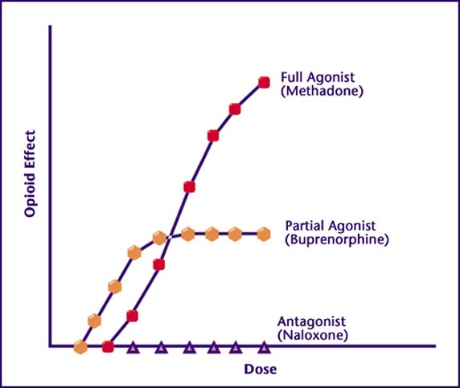
Partial Opioid Agonist: Buprenorphine
Prescribing: Requires completion of certification course to obtain “waiver” and DEA-X license (MDs; NPs and PAs)
Advantages:
  Outpatient clinic management
  Can provide some pain relief
  Safer in overdose compared to full agonist
  Little to no concerns regarding prolonged QTc
  Built-in mechanism to counteract diversion
Concerns if:
  Active ETOH/benzo use
  Caution using bup/naloxone combo in pregnancy- current recommendation is buprenorphine monotherapy

Slide 41
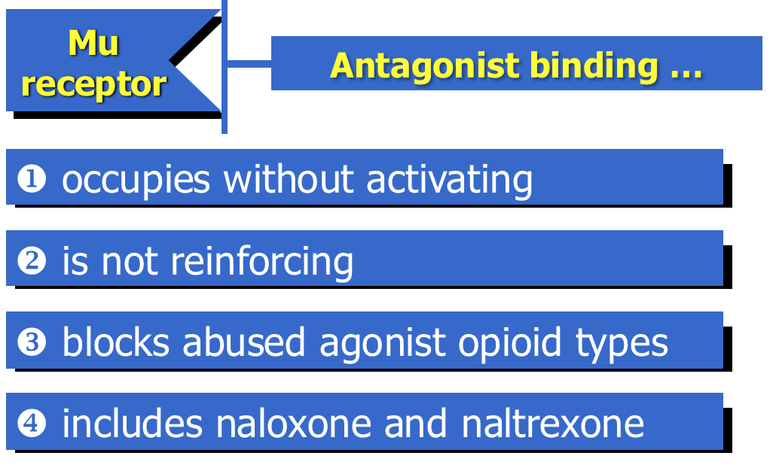
Opioid Antagonist: Naltrexone

Slide 42
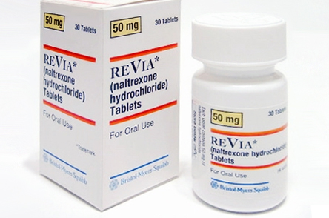
Opioid Antagonist: Naltrexone (oral)
Dosing: 50mg PO daily
Adverse effects:
  GI- abdominal pain, nausea, decreased appetite
  Sedation
  Insomnia
  Reversible hepatotoxicity- monitor LFTs closely
    Avoid in patients with acute hepatitis or liver failure
Works best with compliant patients
Dual indication to treat alcohol use disorder
IMPORTANT: Must be sober from opioids x 5-7 days prior to taking first dose

Slide 43
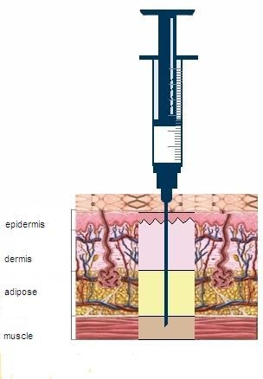
Opioid Antagonist: Extended-Release Naltrexone (IM, Vivitrol)
1 injection per month: 380 mg
Microspheres of naltrexone and polymeric matrix.
Advantages:
  Given q4 weeks; Better adherence with once monthly dosing
  can be administered in clinician’s office
  More stable plasma concentrations compared to oral formulation
Adverse effects:
  Nausea and headaches
  More sedation than with oral formula
  Injection site reactions
  Hepatotoxicity- monitor LFTs
Notes:
Can cause hepatocellular injury in very high doses (eg 5-10 times higher than normal)
Contraindicated in acute hepatitis or liver failure
Check liver function before, q1 month for 3 months, then q 3 months (this recommendation comes from the VA/DoD guidelines for naltrexone use)
Contraindicated if patient needs opioid analgesia
Ibuprofen, acetominophen, or other non-steroidal anti-inflammatory agents may be associated with GI or hepatic adverse events and patients should be followed for use of these medications and side effects
Common Side Effects: nausea/headache
VA/DoD CPG SUDs, www.oqp.med.va.gov

Slide 44
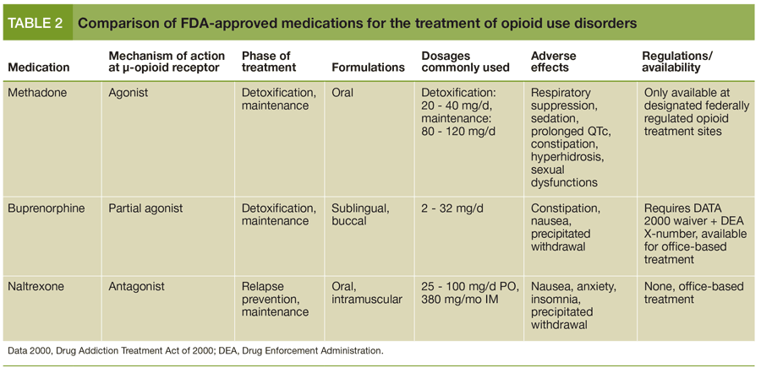
Medication-Assisted Treatment

Slide 45
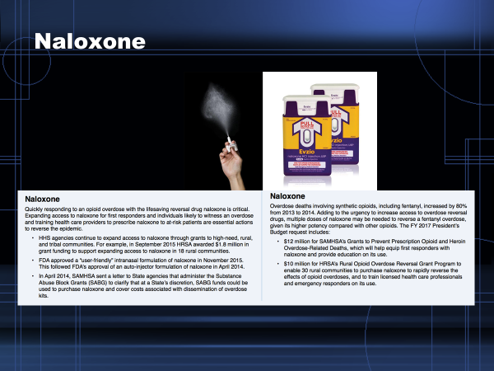
Preventive measures: Opioid antagonist (Naloxone)

Slide 46
Conclusions: Patients with Substance Use Disorder, Pain and Co-Occurring Mental Illness
Depression and anxiety are the most common psychiatric disorders seen in chronic pain patients
These patients report more severe pain and disability , are less likely to adhere to treatment and have poorer outcomes
Attention to assessment and treatment of chronic pain and concurrent psychiatric disorders is necessary to improve treatment outcomes

Slide 47
Conclusions: Patients with Substance Use Disorder, Pain and Co-Occurring Mental Illness
Develop a Biopsychosocial Treatment Plan
Begin with chronic Pain Self Management Program
Incorporate CBT
Pharmacotherapy/Psychoeducation for depression, anxiety, psychosis & PTSD
  Choose non abusable medications
  Adequate doses for an adequate time

Slide 48
Conclusions: Patients with Substance Use Disorder, Pain and Co-Occurring Mental Illness-
All chronic pain patients should be screened for psychiatric disorders, including PTSD and SUDs
SI requires assessment
A patient with a current SUD may require detoxification before pain treatment can proceed
It is important to distinguish substance-induced disorders from independent psychiatric disorders

Slide 49
What are the risks for SUD in depressed patients on chronic opioid therapy?
Patients with moderate to severe depression are 1.8 and 2.4 times more likely, respectively, to misuse opioid medications to relieve these symptoms (Grattan 2012)
Such patients will benefit from pharmacotherapy with standard antidepressant meds
There are no clear guidelines to guide choice of medication, though consideration should be given to venlafaxine and duloxetine because of their efficacy in chronic pain management (Cheatle 2006)
Grattan A, et al., 2012, Annals Family Med 10(4):304-311
Cheatle MD, Gallagher RM, 2006,Current Psych Reports 8:371-376

Slide 50
Thanks
Look Out for
each other

