Slide 1


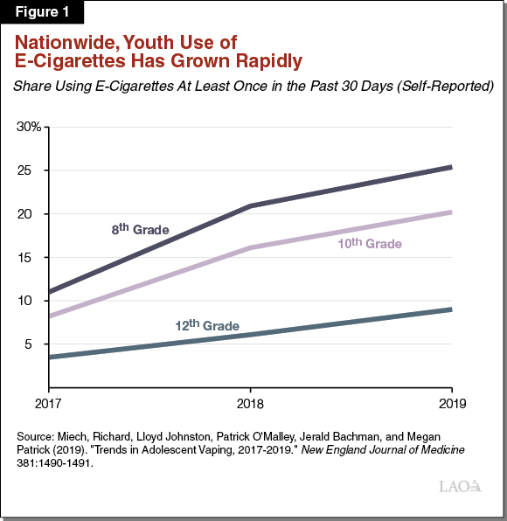
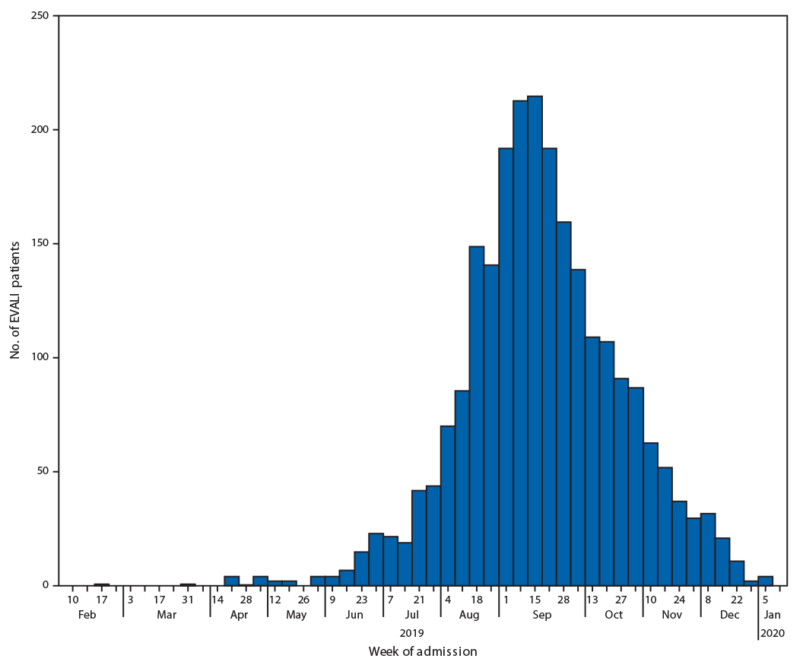
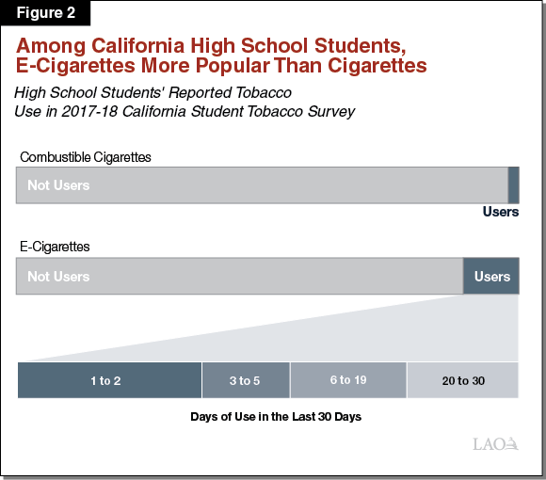
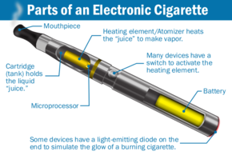
VAPING, ITS EFFECTS & THE CA EDUCATION CODE
Robert A. Bitonte¹, M.D., M.A., J.D., LL.M & Maria Erlinda Santiago², R.N., B.S.N., J.D. candidate’ 21
¹Los Angeles County Medical Association & ²Southwestern Law School
ABSTRACT
Effects & Ongoing Problem with Vaping
Prevalence of Vape Use Among Youths
E-cigarettes Erased the Progress Made in Reducing Tobacco Product Use Decades Earlier
Electronic cigarettes’ popularity has undermined the progress made by the Tobacco-Free campaign in reducing tobacco use and nicotine addiction among the youth.¹ Contributing factors include curiosity, availability of “cool” tobacco flavors and having relatives and friends who use e-cigarettes.^{2,3,4}
Though the California Education Code §51202 requires school districts to offer a course of study at appropriate elementary and secondary grade levels that includes the effects of tobacco,⁵ there is a general nescience about e-cigarettes, vape, vape-use and its ill effects among school administrators, teachers and parents.⁶
In the summer of 2019, the nation saw an outbreak of severe lung injures associated with vaping.¹⁰ Affected vape users saw their condition rapidly deteriorating eventually requiring intubation and ventilation. According to the Center of Disease Control (CDC), the increase in EVALI cases or E-cigarette or Vaping product use-Associated Lung Injury continued until September 2019, at which point new cases declined. (See below).¹⁰ As of February 18, 2020, there has been reports of 2807 hospitalizations and 68 deaths have resulted from these injuries.¹⁰
The introduction of e-cigarette caused a spike in number of students who use tobacco. In 2018, 20.8% of high school used e-cigarettes, an increase of nearly 80% over the 11.7% in 2017.¹⁶ Middle school students who vaped increased by nearly 50% at the same time.¹⁶ Other use of tobacco products did not change significantly.¹⁶ Thus, the spike in e-cigarette use effectively erased recent progress in reducing overall tobacco product use among youths.¹⁶
California Education Code
Image Credit: LAO (Legislative Analyst’s Office), The 2020-2021: Budget, Taxation of E-cigarettes (February 24, 2020).
While the California Education Code recognizes e-cigarettes as a tobacco product, many of the school administrators and teachers do not know what e-cigarettes are.¹⁷ Less than half (47%) of high school and middle school teachers recognize a JUUL device.¹⁸ 35% of the teachers mistook an e-cigarette for a USB drive or other container and 18% could not identify the device at all.¹⁸
OBJECTIVES
The use of e-cigarettes has grown rapidly in the country over the last few years. According
a survey done by The New England Journal of Medicine, the number of 12th graders who used e-cigarettes from 2017 has increased from 11% to 25% in 2019, while for eight graders, the number increased from 3% in 2017 to 9% in 2019.¹⁴ For tenth graders, the number increased from 8.2% in 2017 to 20.2% in 2019.¹⁴ This means 1 in 4 high school seniors have vaped in the last 30 days while 1 in 5 of 10th graders have vaped. One in 10 of 8th graders have vaped in the last 30 days.¹⁴
In the annual survey done by the CDC for the National Youth Tobacco Survey (NYTS), the increase in vape use among adolescents is attributed to curiosity, with 55.3% of the students citing this as a reason, “friends or family used them” with 30.8% of the students reporting this as the reason and 22.4% of the students reported that it was the flavors that made them try e-cigarettes.¹⁵
What is an e-cigarette?;
Effects of vaping and the ongoing problem with EVALI;
Prevalence of vaping among the youths especially among California high school students;
E-cigarettes erased the progress made in reducing tobacco use decades earlier;
The California Education Code and the problem of not knowing.
Conclusion
While school administrators, educators and parents should be more familiar with e-cigarettes, there should also be an audit and compliance provision in the California Education Code to ensure that middle school and high school students learn about the ill effects of vaping and vape-use.
What is an E-cigarette?
The California Department of Education uses the Business and Professions Code §22950.5 to define e-cigarettes as “an electronic device that delivers nicotine or other vaporized liquids to the person inhaling from the device, including but not limited to, an electronic cigarette, cigar, pipe or hookah.”^{7, 8}
Instead of lighting a cigarette, the battery-powered device works by heating a liquid solution and vaporizing or aerosolizing it.⁹ The user then inhales the aerosol or vapor, an act called “vaping.” The liquid solution typically contains nicotine, propylene glycol (PG), vegetable glycerin (VG) and usually mixed with flavorings.⁹ THC (tetrahydrocannabinol – the principal psychoactive component in marijuana), which uses vitamin E acetate as a diluent, is also another type of liquid solution that can be purchased.⁹
Image credit: CDC, Outbreak of Lung Injury Associated with the use of E-cigarette, or Vaping Products,
References
The CDC identified vitamin E acetate (tocopheryl acetate) as a key contributing factor in EVALI. It was used as a thickening agent for THC.¹⁰ One study showed that the pyrolysis (heating) of Vitamin E acetate in the vape mixture releases the toxic gas ketene along with other reactive and known carcinogens like alkenes and benzene. Once inhaled, even in small quantities, ketene can cause severe pulmonary injury.¹¹
Another study shows that once pyrolysis of VEA occurs, it returns to its oil state after the user inhales the substance. In the study published by The New England Journal of Medicine, thirty mice were exposed to aerosolized VEA.¹² The lungs of the mice contained numerous lipid-laden macrophages.¹²
Those affected with EVALI present symptoms that include shortness of breath, cough, chest pain, fever and chills, diarrhea, nausea, vomiting, tachycardia (rapid heart beat) and tachypnea (rapid and shallow breathing).¹³
CDC, Progress erased: Youth Tobacco Use Increased During 2017-2018 (February 11, 2019) https://www.cdc.gov/media/releases/2019/p0211-youth-tobacco-use-increased.html (last visited August 2, 2020).
J.K. Pepper et. al., Adolescents’ interest in trying flavored e-cigarettes, 25 Tobacco Control. ii62, ii64-ii65 (2016) https://tobaccocontrol.bmj.com/content/25/Suppl_2/ii62.
Adam M. Leventhal. Flavored E-cigarette Use and Progression of Vaping in Adolescents, Official J. of the Am. Acad. of Pediatrics (2019). https://pediatrics.aappublications.org/content/144/5/e20190789.
Karma McKelvey et. al., Youth say ads for flavored e-liquids are for them, 91 Addict Behav. 164, 169-170 (2018) https://www.ncbi.nlm.nih.gov/pmc/articles/PMC6663555/ (last visited June 28, 2020).
Cal. Educ. Code – Gen. Provisions § 51202 (West 2020).
Truth Initiative, How are Schools Responding to JUUL and the Youth E-cigarette Epidemic? https://truthinitiative.org/research-resources/emerging-tobacco-products/how-are-schools-responding-juul-and-youth-e-cigarette (last visited July 28, 2019).
Cal. Bus. & Prof. Code § 22950.5 (West 2020).
Cal. Dept. of Educ. Students (November 24, 2019) https://www.cde.ca.gov/ls/he/at/tobpolicyregs.asp (last visited August 2, 2020).
What We know About Electronic Cigarettes. https://smokefree.gov/quit-smoking/ecigs-menthol-dip/ecigs (last visited July 18, 2020).
CDC, Outbreak of Lung Injury Associated with the use of E-cigarette, or Vaping Products (February 25, 2020) https://www.cdc.gov/tobacco/basic_information/e-cigarettes/severe-lung-disease.html#overviewCDC.gov (last visited August 2, 2020).
Dan Wu & Donal O’Shea. Potential for Release of Pulmonary Toxic Ketene from Vaping Pyrolysis of Vitamin E Acetate, 117 Proc. of the Nat’l Acad. of Sci. of the U.S. 6349, 6354 (2020) https://www.pnas.org/content/pnas/117/12/6349.full.pdf.
Tariq A. Bhat et. al., An Animal Model of Inhaled Vitamin E acetate and EVALI-like Lung Injury. 382 New Eng. J. of Med. 1175, 1175-1177 (2020) https://www.nejm.org/doi/pdf/10.1056/NEJMc2000231?articleTools=true.
E-cigarette or Vaping Product Use- Associated Lung Injury (EVALI). https://www.yalemedicine.org/conditions/evali/ (last visited August 2, 2020).
Richard Miech et. al., Trends in Adolescent Vaping, 2017-2019. 381 New Eng. J. of Med. (2019) https://www.nejm.org/doi/pdf/10.1056/NEJMc1910739.
Teresa W. Wang, et. al., Tobacco Product Use and Associated Factors Among Middle and High School Students. MMWR. (December 5, 2019). https://www.cdc.gov/mmwr/volumes/68/ss/pdfs/ss6812a1-H.pdf (last visited August 2, 2020).
CDC, Progress erased: Youth Tobacco Use Increased During 2017-2018 (February 11, 2019) https://www.cdc.gov/media/releases/2019/p0211-youth-tobacco-use-increased.html (last visited August 2, 2020).
Barbara A. Schillo, JUUL in School: Teacher and Administrator Awareness and Policies of E-Cigarettes and JUUL in U.S. Middle and High Schools. 21 Health Promot Pract. 20, 20-24 (2020) https://journals.sagepub.com/doi/10.1177/1524839919868222?url_ver=Z39.88-2003&rfr_id=ori:rid:crossref.org&rfr_dat=cr_pub%20%200pubmed.
Truth Initiative, How are Schools Responding to JUUL and the Youth E-cigarette Epidemic? https://truthinitiative.org/research-resources/emerging-tobacco-products/how-are-schools-responding-juul-and-youth-e-cigarette (last visited July 28, 2019).
Image credit: LAO (Legislative Analyst’s Office), The 2020-2021: Budget, Taxation of E-cigarettes
(February 24, 2020).
CONTACT
Image Credit: Wikipedia
Presented at the California Society of Physical Medicine and Rehabilitation
2020 Virtual Meeting
Robert A. Bitonte M.D., M.A, J.D, LL.M. – Rbitonte@aol.com
Maria Erlinda Santiago R.N., B.S.N., J.D. candidate 2021 – msantiago16@swlaw.edu

