Slide 1
Ultrasound and Interventional Treatment for Knee Pain
Bianca Tribuzio, DO
CSPMR 2021

Slide 2
Disclosures
No relevant disclosures

Slide 3
Outline
Ultrasound Basics
Knee Ultrasound
Knee Osteoarthritis
Current treatment options
Genicular Nerve radiofrequency ablation
Notes:
after outline: this is a procedure that when I finished fellowship and joined faculty here almost 6 years ago I knew nothing about however realized quickly once I learned more about it how it may benefit a significant number of patients

Slide 4
Ultrasound Basics
Choose a Transducer
  Linear, curvilinear
  Higher Frequency : better resolution, less penetration
Holding Transducer, Ergonomics
  Hold close to patient
  Rotate, toggle, heel-toe
  Anisotropy: different in different directions
Terminology
  Hypoechoic: dark (relative to other structures), fluid
  Hyperechoic: bright (relative to other structures), bone (acoustic shadow)
  Anechoic/isoechoic
Notes:
Ergonomics:
Monitor at eye level.
Sitting comfortably with patient, palmar grasp of transducer
Keep patient close to use, posture alignment

Slide 5
Benefits of Ultrasound for Knee
Allows details inspection of soft tissue (tendon, ligaments, nerve)
Allows dynamic evaluation
No artifact form hardware
Limitations of intraarticular structures

Slide 6
Ultrasound of the Lower Extremity
Focused or target exam
Transducers: High Frequency probe preferred for knee
Assume a comfortable scanning position and then move the joint to assess ligament and joint laxity
Follow tendons from myotendinous junction to bone insertion
Know your bone/osseous acoustic landmarks
Preferred to image in long and short access
Doppler
Notes:
Doppler can be helpful with evaluating fluid (synovitis, bursitis, neovascularization as seen in tendinosis)

Slide 7
Focused Exam of the Knee
Four Quadrants
Anterior: Quadriceps tendon, Patella, Patellar tendon, Patellar retinaculum, Suprapatellar recess, Pre-­‐patellar bursa
Medial: Medial collateral ligament, Medial meniscus, PesAnserine tendons and bursa
Lateral: Iliotibial tract, Lateral collateral ligament, Biceps Femoris tendon, Common peroneal nerve, Popliteus, Lateral Meniscus
Posterior: Baker’s cyst, Neurovascular structures
Notes:
Four quadrants accepted by American Medical Society for Sports Medicine (AMSSM) and European Society of Musculoskeletal Radiology

Slide 8
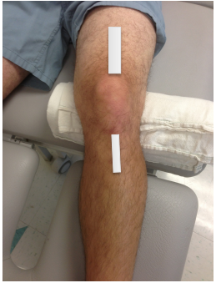
Anterior Knee Exam
Patient supine, knee flexed to thirty degrees, pillow under knee
In this position, the following structures can be assessed
a. Quadriceps tendon
b. Suprapatellar recess
c. Pre‐patellar bursa
d. Patellar retinaculum
e. Patella
f. Patellar tendon

Slide 9
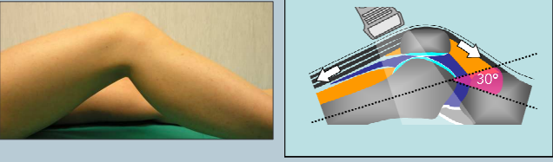
Anterior Knee:
Can eval extensor mechanism.
Keep probe over bony landmarks
Look in short and long access.
ESSR Musculoskeletal Ultrasound Technical Guidelines for Knee

Slide 10
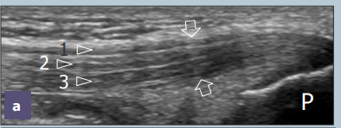
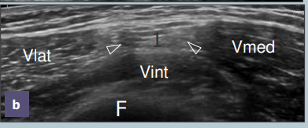
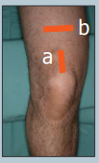
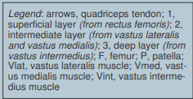
Anterior Knee: Quadriceps Tendon
Sagittal US, Long access
Short Access
ESSR Musculoskeletal Ultrasound Technical Guidelines for Knee

Slide 11
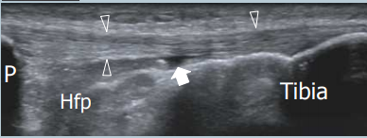
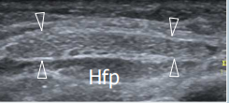



Anterior Knee:
Patella, Patella Tendon
ESSR Musculoskeletal Ultrasound Technical Guidelines
Short Access
ESSR Musculoskeletal Ultrasound Technical Guidelines for Knee

Slide 12
Signs of tendinosis
Hypoechoic swelling
Neovascular changes seen with doppler

Slide 13
Medial Knee
Bring hip into external rotation with knee flexed 20-30 degrees.
Scan the following:
Medial Collateral Ligament
Body of Medial Meniscus
Pes Anserine tendons and bursa

Slide 14
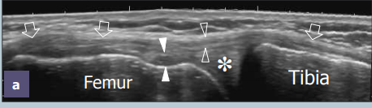
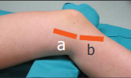
Medial Knee:
Medial Collateral Ligament
With leg externally rotated, Long access view.
Note distal MCL insertion to pes anserine tendons
ESSR Musculoskeletal Ultrasound Technical Guidelines for Knee

Slide 15
Lateral Knee
Bring hip into internal rotation with knee flexed 20-30 degrees.
Scan the following:
iliotibial band
Lateral collateral ligament, biceps femoris tendon
Common peroneal nerve
Popliteus
Lateral meniscus

Slide 16
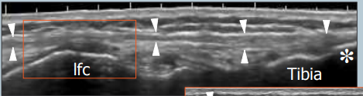

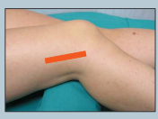
IT band
IT band, best examined in long axis.
ESSR Musculoskeletal Ultrasound Technical Guidelines for Knee

Slide 17
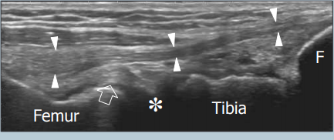

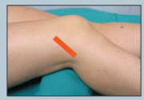
Lateral Collateral Ligament
Find bony landmark of fibular head.
ESSR Musculoskeletal Ultrasound Technical Guidelines for Knee

Slide 18
Posterior Knee
Patient prone, pillow under patella.
Scan Following structures:
  Baker’s cyst (Semimembranosus-gastrocnemius bursa)
  Neurovascular
  Posterior horn medial and lateral meniscus
  PCL insertion

Slide 19
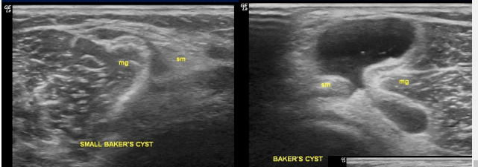
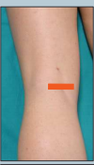
Baker’s Cyst
Medial Gastrocnemius muscle
Semimembranosis tendon
ESSR Musculoskeletal Ultrasound Technical Guidelines for Knee
Jon Halperin Musculoskeletal Ultrasound of the Knee, Foot, and Ankle

Slide 20
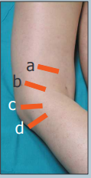
Peroneal Nerve
Start with origin of common peroneal from sciatic nerve following distally.
Peroneal nerve is posterior to biceps femoris
ESSR Musculoskeletal Ultrasound Technical Guidelines for Knee

Slide 21
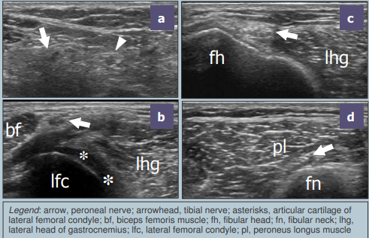
Peroneal Nerve
ESSR Musculoskeletal Ultrasound Technical Guidelines for Knee

Slide 22
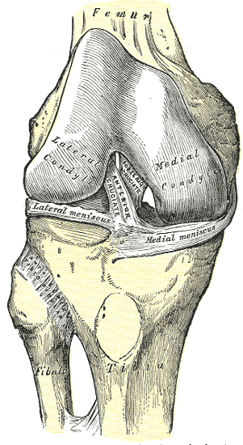
Knee anatomy
Wiki commons

Slide 23
Knee Osteoarthritis
Osteoarthritis is most common joint disorder in US
Non modifiable and modifiable risk factors
Cost to society
OA largely affects weight bearing joints
Notes:
Zhang Y, Jordan JM. Epidemiology of Osteoarthritis. Clin Geriatr Med. 2010 Aug; 26(3): 355–369.
Non modifiable: age 35 million ppl in US 65 and older and over half with radiographic evidence of OA in at least 1 joint
Modifiable: weight: 2010 CDC reported that 65.7% adults at least overweight and by 2030 estimated that 20% (70 million ppl) will be at risk for OA
Surgical treatment options alone estimated cost around $12 billion and societal impact of absenteeism resulting from OA estimated at similar value

Slide 24
AAPMR endorsed guidelines for knee OA
AAOS Clinical Practice Guideline on Treatment of Osteoarthritis of the Knee (2nd Edition) (2013) - This guideline was affirmed by the AAPM&R Clinical Practice Guidelines (CPG) Committee, a determination with which the AAPM&R Board of Governors agreed. This guideline was developed by the American Academy of Orthopaedic Surgeons.
Recommendations for the use of nonpharmacologic and pharmacologic therapies in osteoarthritis of the hand, hip, and knee (2012) - This guideline was affirmed by the AAPM&R Clinical Practice Guidelines (CPG) Committee, a determination with which the AAPM&R Board of Governors agreed. This guideline was developed by the American College of Rheumatology (ACR)

Slide 25
2013 AAOS Treatment of Osteoarthritis of Knee
Conservative Treatment Recommendations:
  1. Recommend patients with symptomatic OA participate in self management program, strengthening, low impact exercise
  2. Suggest weight loss for BMI>25
  3A. Cannot recommend acupuncture
  3B.Unable recommend for/against physical agents
  3C. Unable recommend for/against manual therapy
  4. Unable recommend for/against medial unloader brace
  5. Cannot suggest lateral wedge insert
  6. Cannot recommend glucosamine, chondroitin
Notes:
American Academy of Orthopaedic Surgeons. Treatment of Osteoarthritis of the Knee – 2nd Edition
Evidence-Based Clinical Practice Guideline. https://www.aaos.org/globalassets/quality-and-practiceresources/
osteoarthritis-of-the-knee/osteoarthritis-of-the-knee-2nd-editiion-clinical-practice-guideline.pdf.
Published May 18, 2013.

Slide 26
2013 AAOS Treatment of Osteoarthritis of Knee
Pharmacologic Treatment Recommendations:
  7A. Recommend nsaids or tramadol
  7B Unable recommend for/against acetaminophen, opioids
Notes:
American Academy of Orthopaedic Surgeons. Treatment of Osteoarthritis of the Knee – 2nd Edition
Evidence-Based Clinical Practice Guideline. https://www.aaos.org/globalassets/quality-and-practiceresources/
osteoarthritis-of-the-knee/osteoarthritis-of-the-knee-2nd-editiion-clinical-practice-guideline.pdf.
Published May 18, 2013.

Slide 27
2013 AAOS Treatment of Osteoarthritis of Knee
Procedural Treatments Recommendations:
  8. Unable recommend for/against intraarticular corticosteroids
  9. Cannot recommend hyaluronic acid
  10. Unable recommend for or against growth factor and or platelet rich plasma
  11. Cannot suggest use needle lavage
Notes:
American Academy of Orthopaedic Surgeons. Treatment of Osteoarthritis of the Knee – 2nd Edition
Evidence-Based Clinical Practice Guideline. https://www.aaos.org/globalassets/quality-and-practiceresources/
osteoarthritis-of-the-knee/osteoarthritis-of-the-knee-2nd-editiion-clinical-practice-guideline.pdf.
Published May 18, 2013.

Slide 28
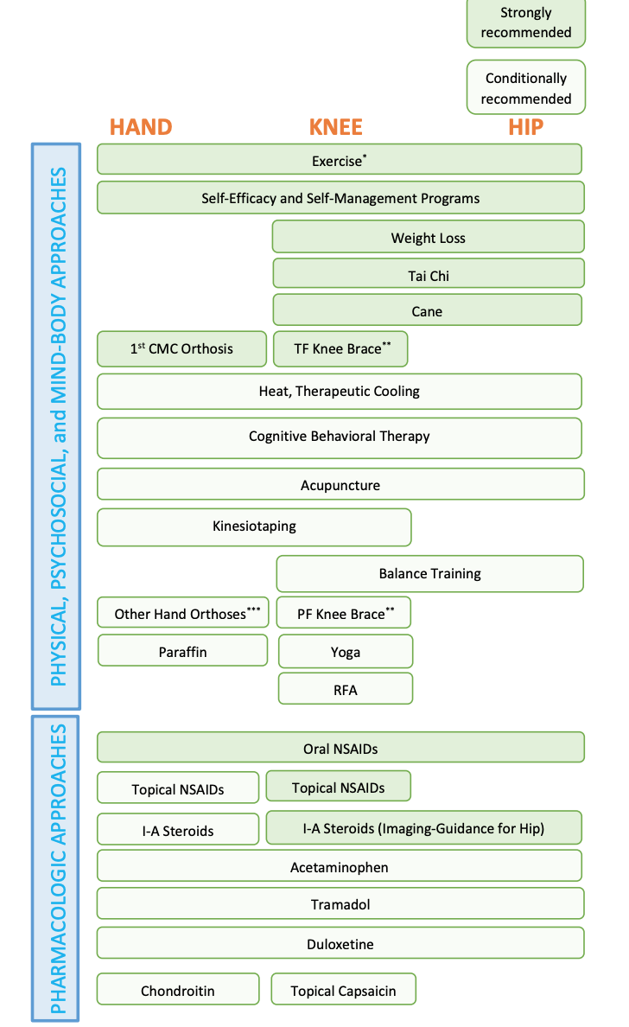
2019 ACR Guidelines for management of OA
Notes:
Kolasinski et al. 2019 American College of Rheumatology/Arthritis Foundation Guideline for the Management of Osteoarthritis of the Hand, Hip, and Knee. Arthritis&Rheumatology 2020: 220-233 Vol 72. https://www.rheumatology.org/Portals/0/Files/Osteoarthritis-Guideline-Early-View-2019.pdf

Slide 29
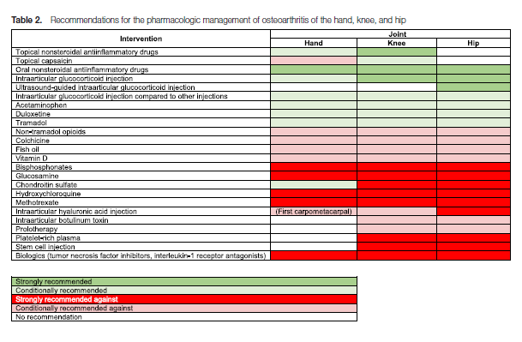
2019 ACR Guidelines for Management of OA
Notes:
Intararticular hyaluronic acid injections conditionally recommended against in patients with knee OA. In prior systemic reviewed, benefits have been reported. Paper believed reviewed didn’t take into account the risk of bias of individual studies. “The finding that best evidence fails to establish a benefit and that harm may be associated with these injectiosn motivated the recommendation against use of this treatment”. In clinical practice, use of these may be viewed more favorably. Shared decision making.

Slide 30
Current Treatments for knee OA
Medications
PT
Steroid injections
Hyalaronic Acid Injections
?Regenerative medicine
Surgery
Radiofrequency ablation?
Notes:
NSAIDs, Tylenol, topical medications voltaren gel/lidocaine ointment, SNRI, TCA, gabapentin, muscle relaxants, last option opiates
PT: land based or aqua
Steroid injections: no more than 3-4 in a year- may increase risk of cartilage degeneration, patient with DM may increase BS temporarily
HA acid: no more than 2 in a year. AAOS in a statement said not efficacious therefore some insurance companies may not cover
Regen Med: Prolo, PRP, stem cells-
Surgery: TKR, in 2010 total number hospital discharges related to knee joint arthroplasties due to OA was 155,000 per quarter with up to 44% patients experience pain after apparently successful surgery

Slide 31
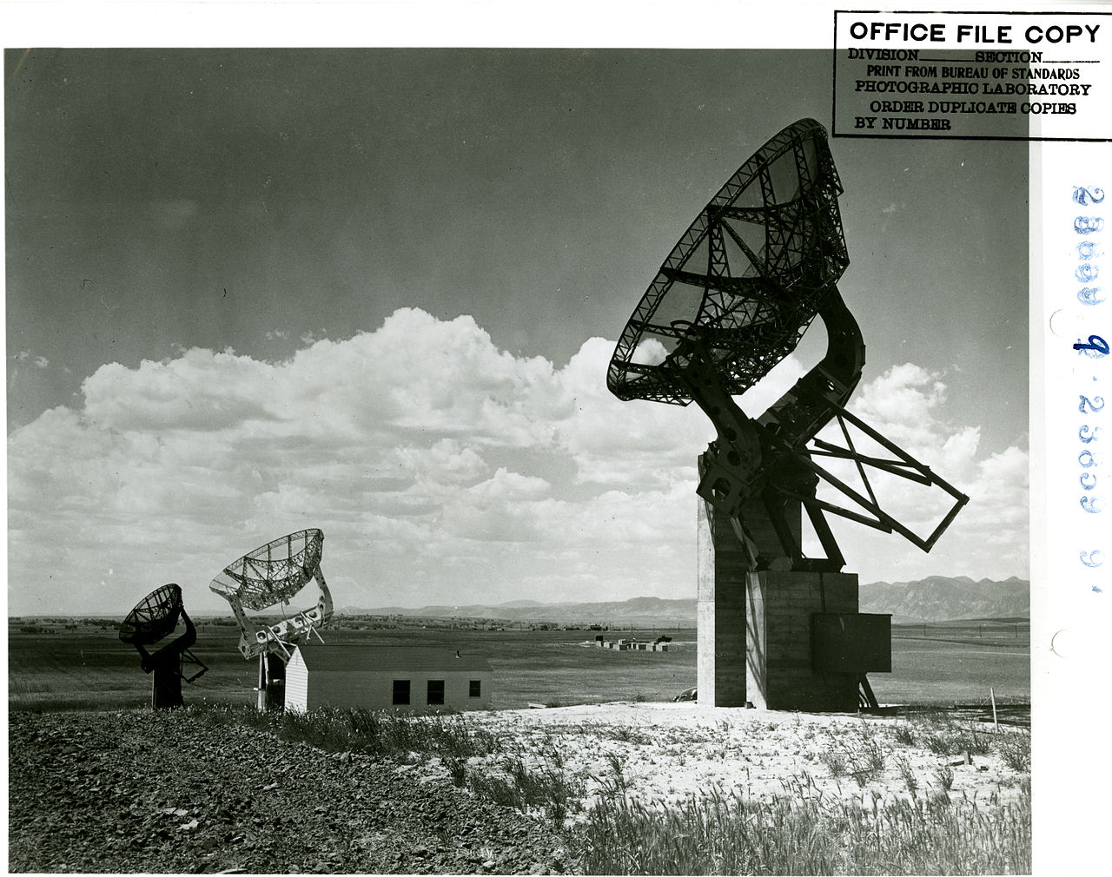
What is Radiofrequency Ablation
Wiki commons
Notes:
since 1950's electrical currents have been used to create predictable thermal lesions however use of radiofrequency ablation for intractable pain first appeared in the literature in the 1970s.passage of radiofrequency currents through an electrode that is placed nearby a nociceptive pathway to interrupt the pain impulses.
What is RFA: thermal energy creates a predictable area of tissue destruction that is targeted to contain the nerve responsible for transmitting and or modulating pain sensation
In the procedural stetting the RF ablation needle tip acts as a cathode of an electrical circuit which is closed by a dispersing grounding pad placed elsewhere on the body. The electrode itself however does ot heat up and is not hot to touch- it generates an alternating electromagnetic field that sets nearby molecules into motion. Energy lost between these molecules results in temperature increase. These molecules become the sources of heat which is transmitted farther by tissue connectivity

Slide 32
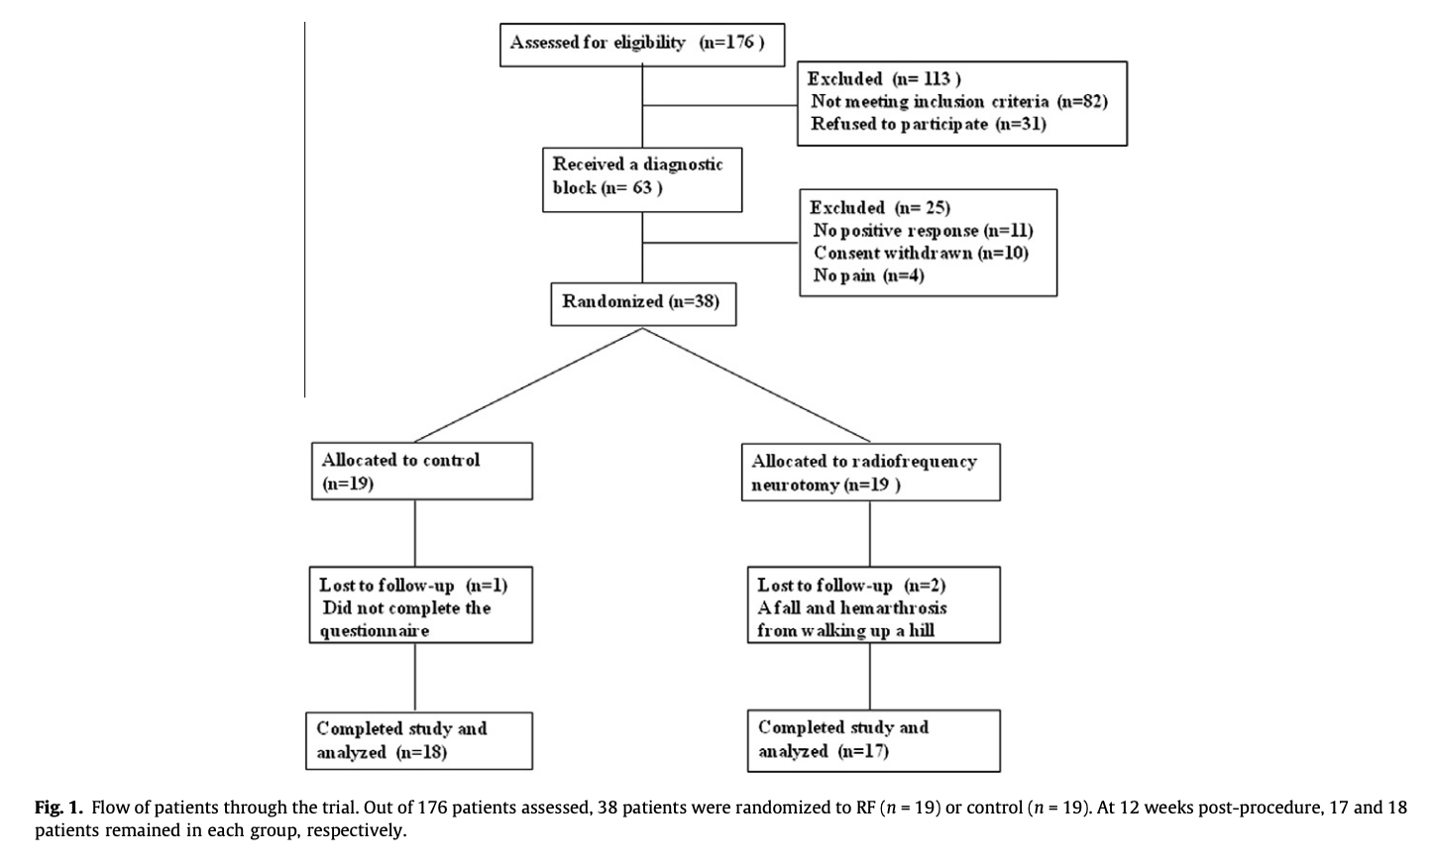
First Genicular Nerve RFA Study 2011
Knee joint innervated by articular branches of various nerves including femoral, common peroneal, saphenous, tibial and obturator nerves
Articular branches around the knee are known as genicular nerves
First study to determine whether RFA genicular nerves can relieve chronic knee OA pain
Notes:
Methods: Randomized, double blinded, sham lesion controlled study conducted at Pain Clinic of Asan Medical Center in Seoul. Patients age 50-80 with knee pain. After clinical and radiologic assessment study subjects comprised elderly patients with chronic knee pain- moderate intensity of greater on most or all days >3 months, and xray OA kellgren Lawrence grade 2-4, did not respond of other treatments including PT, oral medications, steroid injections of HA injections. Exclusion criteria included acute knee pain, prior knee surgery, other connective tissue disease affecting the knee, neurologic or psychiatric disorders, any knee injections in prior 3 months, pacemakers or anticolagulants
Eligible patients underwent diagnostic genicular nerve blocks with local anesthetic under fluoroscopic guidance including superiorlateral, superiomedial, inferiomedial genicular nerves, 2 ml lidocaine 2 % injected into each and positive response was decrease in numeric pain scores of at least 50% for more than 24 hours then included in RF procedure.
Patients randomly assigned to receive RF or same procedure without effective neurotomy

Slide 33
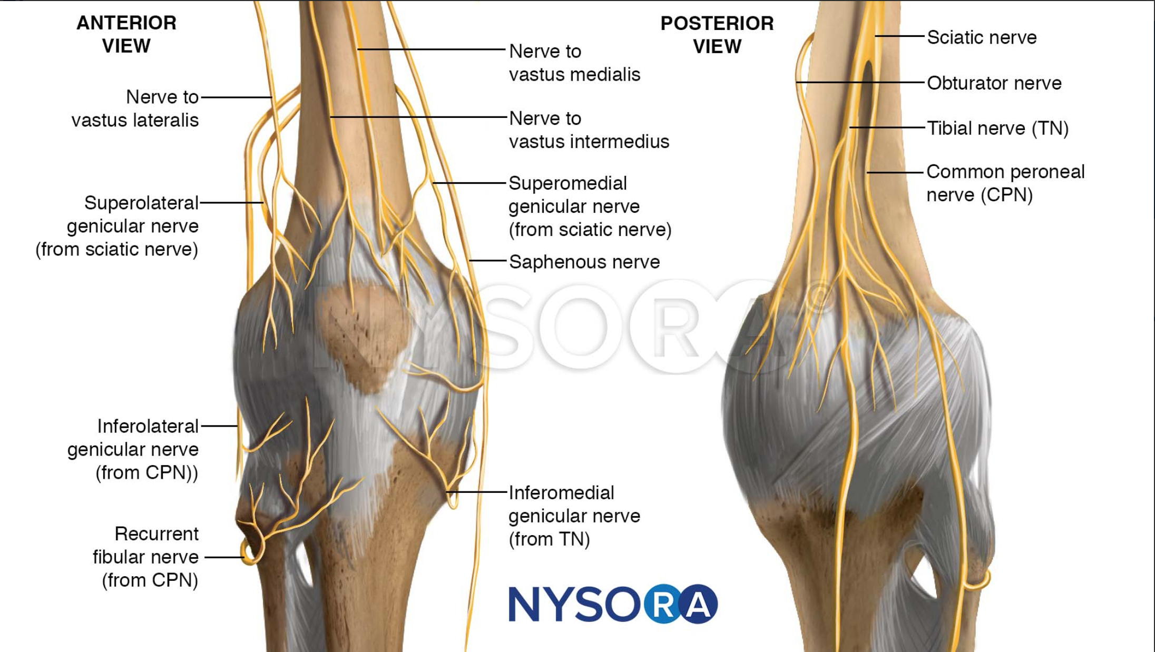
Targets for genicular nerve RFA
https://www.nysora.com/news/new-addition-to-nysoras-web-app/attachment/le_ipack_anatomy_knee-innervation/
Notes:
Typical landmarks for genicular nerve RFA include the superior lateral genicular nerve from the sciatic. Superiomedial genicular nerve from the sciatic and inteformedial genicular nerve from the tibial nerve.

Slide 34
Protocol for Patient Selection
Reddy et al 2016 published “Cooled Radiofrequency Ablation of Genicular Nerves for Knee Osteoarthritis Pain: A Protocol for Patient Selection and Case Series”
Patients who failed conservative management for chronic knee pain due to OA and either not candidate for TKR or wished to avoid surgery offered genicular nerve blocks
Each underwent 1 set of diagnostic blocks, with a positive response as defined as > = 80% reduction in baseline pain while weight bearing and walking
Notes:
Each needle site only used 1mL of 2% lidocaine for the block.
Clinical outcome: reduction pain on numeric rating scale and function by self report as well as changes in analgesic and opioid medication use using medication quantification scale III (MQS3)
4 cases were described in this study- more stringent protocol than prior studies. All 4 patients demonstrated 80-100% improvement in knee pain, function and analgesic medication use at 6-12 months

Slide 35
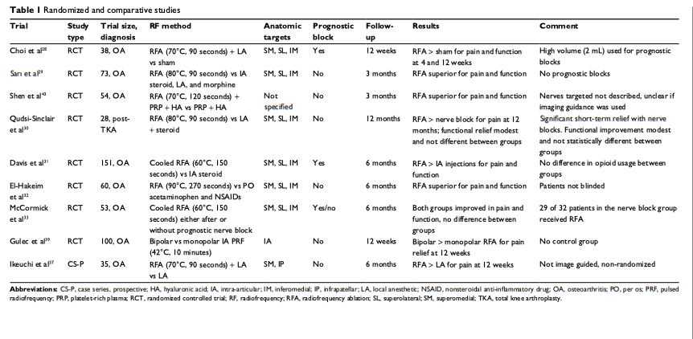
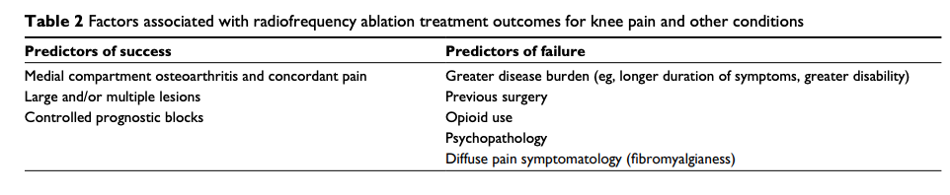
Jamison and
Cohen 2018
Notes:
Medline and google scholar from inception to feb 1, 2018 using key words found 92 trials. For their study looking at comprehensive review of anatomy, effectiveness, treatment parameters and patient selection- they then only reviewed randomized and comparative trials- total of 9 trials identified. 6 compared compared knee RFA to sham but all demonstrated superior pain relief and function with RFA. RFA can be safe and effective treatment for chronic knee pain with duration of benefit ranging from 3-12 months. Predictors of success: medial compartment OA, large or multiple lesions, controlled prognostic blocks. Predictors of failure: greater disease burden, prior surgery, opiate use, psychopathology, diffuse pain symptoms

Slide 36
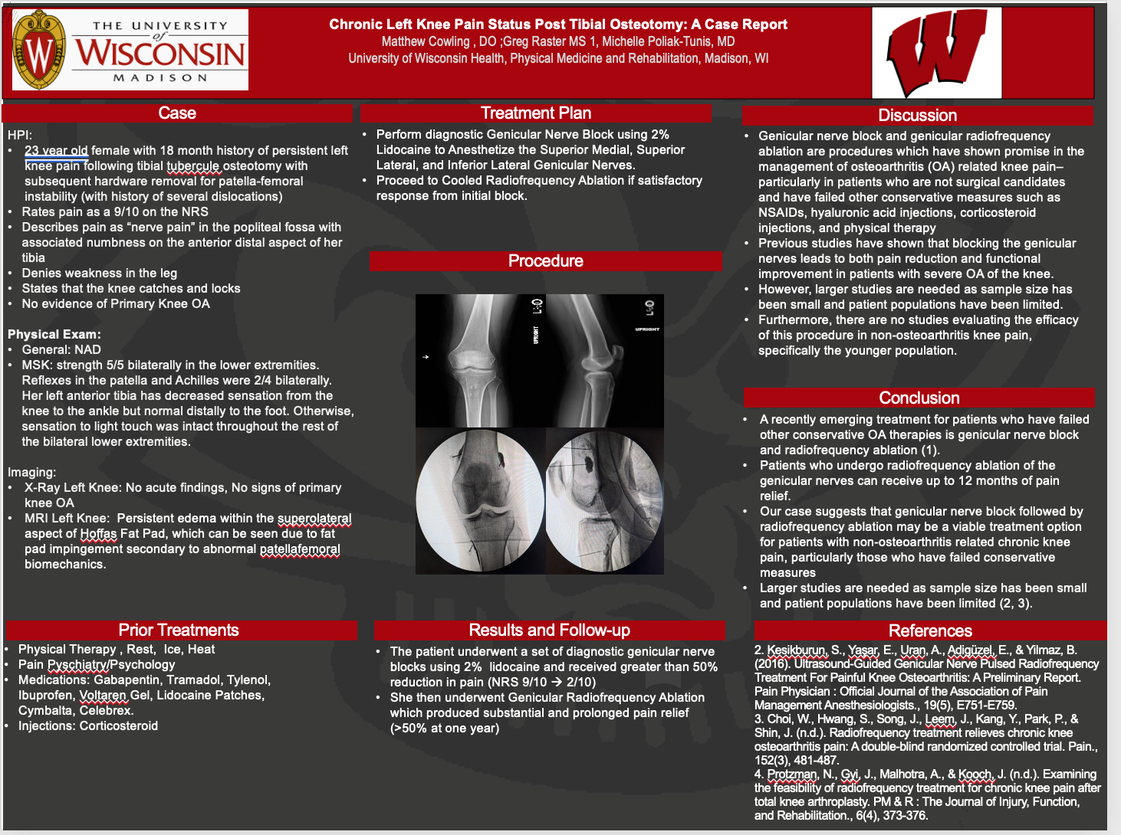
Notes:
First case reported patient with pain post tibial osteotomy using genicular nerve RFA

Slide 37
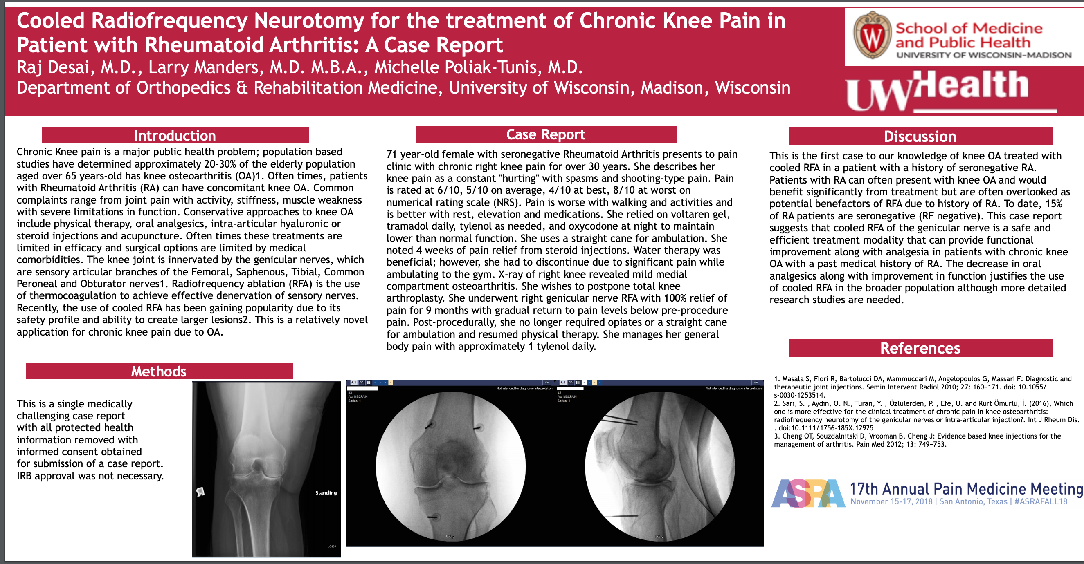
Notes:
First case reported using genicular RFA for RA pain.

Slide 38
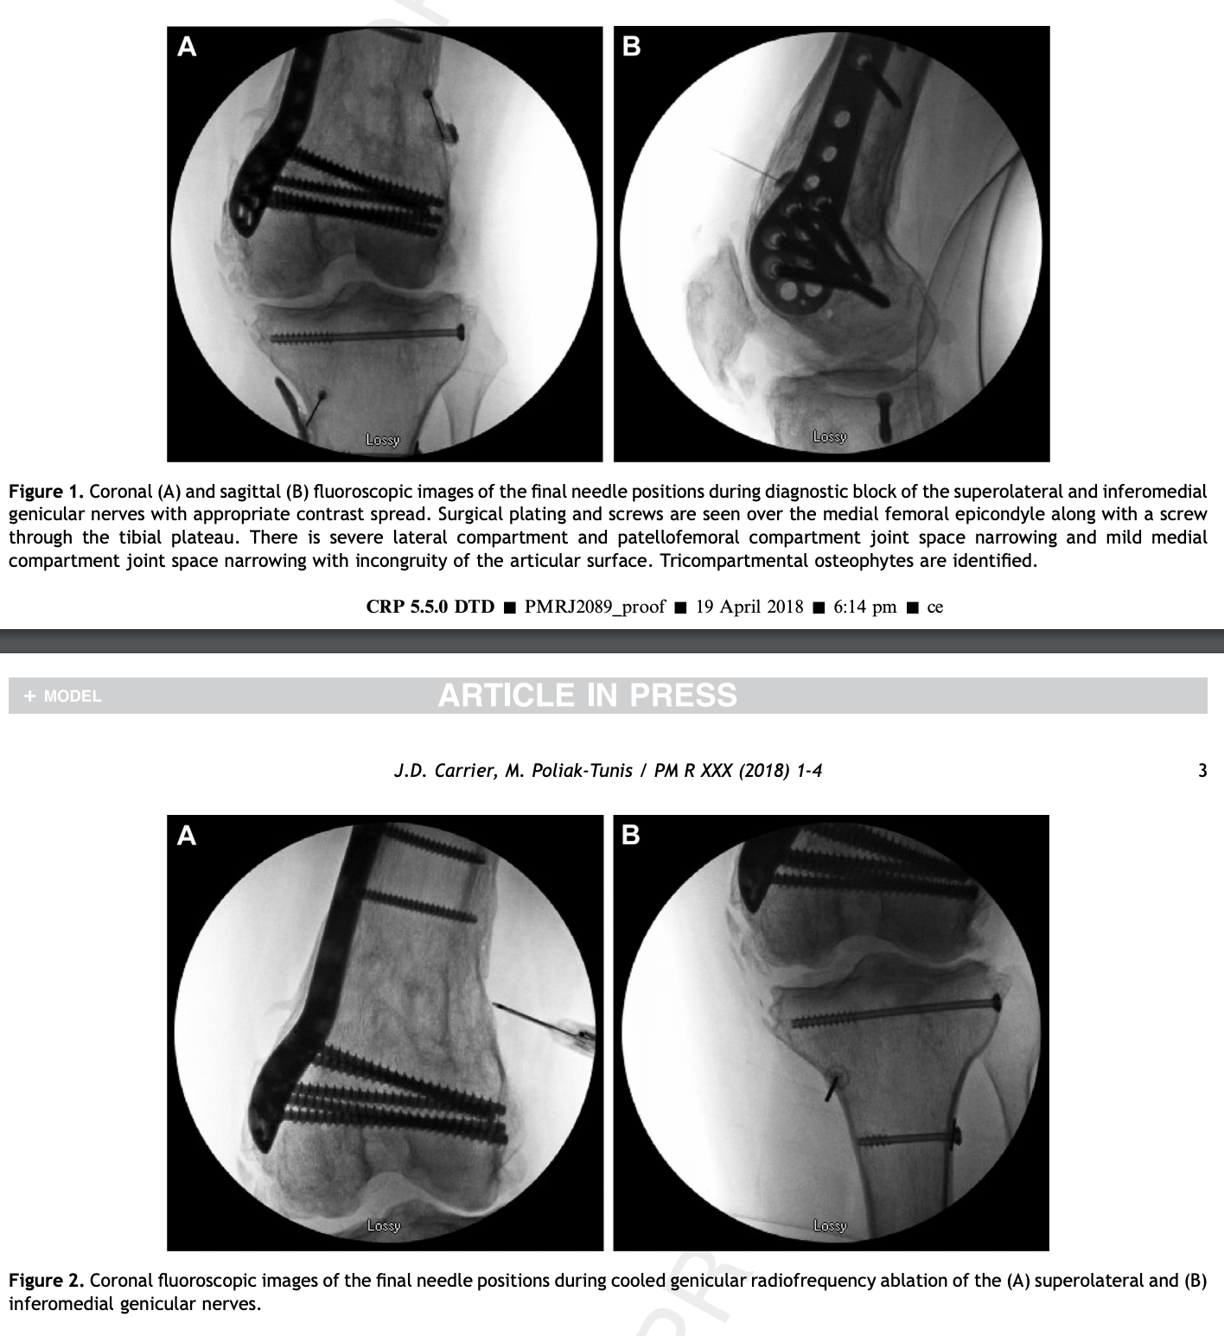
Notes:
20 something yo who was in a terrible MVC 3 years prior requiring over 10 knee surgeries. I told him that we could try diagnostic blocks but not sure if would be helpful. Fortunately, he received significant pain relief and went on to undergo RFA only targeting superior lateral and inferior medial given extensive hardware. Published in purple journal. The procedure provided a >50% reduction in average pain with an increase in activity tolerance lasting 9 months. In this case, C-RFA of the genicular nerves was a safe, effective, and durable treatment modality for post-traumatic knee pain
Carrier JD, Poliak-Tunis M. Genicular Radiofrequency Ablation for the Treatment of Post-traumatic Knee Pain: A Case Presentation. PM R. 2018 Nov;10(11):1279-1282. doi: 10.1016/j.pmrj.2018.03.016. Epub 2018 Apr 5. PMID: 29626612.

Slide 39
references
Chang MC. Efficacy of Pulsed Radiofrequency Stimulation in Patients with Peripheral Neuropathic Pain: A Narrative Review. Pain Physician. 2018;21(3):E225-E234.
Choi WJ, Hwang SJ, Song JG, et al. Radiofrequency treatment relieves chronic knee osteoarthritis pain: a double-blind randomized controlled trial. Pain. 2011;152(3):481-487. doi:10.1016/j.pain.2010.09.029
Reddy RD, McCormick ZL, Marshall B, Mattie R, Walega DR. Cooled Radiofrequency Ablation of Genicular Nerves for Knee Osteoarthritis Pain: A Protocol for Patient Selection and Case Series. Anesth Pain Med. 2016;6(6):e39696. Published 2016 Aug 24. doi:10.5812/aapm.39696
McCormick ZL, Korn M, Reddy R, et al. Cooled Radiofrequency Ablation of the Genicular Nerves for Chronic Pain due to Knee Osteoarthritis: Six-Month Outcomes. Pain Med. 2017;18(9):1631-1641. doi:10.1093/pm/pnx069
McCormick ZL, Reddy R, Korn M, et al. A Prospective Randomized Trial of Prognostic Genicular Nerve Blocks to Determine the Predictive Value for the Outcome of Cooled Radiofrequency Ablation for Chronic Knee Pain Due to Osteoarthritis. Pain Med. 2018;19(8):1628-1638.
Mata J, Valentí P, Hernández B, Mir B, Aguilar JL. Study protocol for a randomised controlled trial of ultrasound-guided pulsed radiofrequency of the genicular nerves in the treatment of patients with osteoarthritis knee pain. BMJ Open. 2017;7(11):e016377. Published 2017 Nov 3. doi:10.1136/bmjopen-2017-016377
Protzman NM, Gyi J, Malhotra AD, Kooch JE. Examining the feasibility of radiofrequency treatment for chronic knee pain after total knee arthroplasty. PM R. 2014;6(4):373-376. doi:10.1016/j.pmrj.2013.10.003
Desai M, Bentley A, Keck WA, Haag T, Taylor RS, Dakin H. Cooled radiofrequency ablation of the genicular nerves for chronic pain due to osteoarthritis of the knee: a cost-effectiveness analysis based on trial data. BMC Musculoskelet Disord. 2019;20(1):302. Published 2019 Jun 26. doi:10.1186/s12891-019-2681-2
Tran J, Peng PWH, Lam K, Baig E, Agur AMR, Gofeld M. Anatomical Study of the Innervation of Anterior Knee Joint Capsule: Implication for Image-Guided Intervention. Reg Anesth Pain Med. 2018;43(4):407-414. doi:10.1097/AAP.0000000000000778
Hirasawa Y, Okajima S, Ohta M, Tokioka T. Nerve distribution to the human knee joint: anatomical and immunohistochemical study. Int Orthop. 2000;24(1):1-4. doi:10.1007/s002640050001
Hochberg MC, Altman RD, April KT, et al. American College of Rheumatology 2012 recommendations for the use of nonpharmacologic and pharmacologic therapies in osteoarthritis of the hand, hip, and knee. Arthritis Care Res (Hoboken). 2012;64(4):465-474. doi:10.1002/acr.21596

Slide 40
references
Kohn MD, Sassoon AA, Fernando ND. Classifications in Brief: Kellgren-Lawrence Classification of Osteoarthritis. Clin Orthop Relat Res. 2016;474(8):1886-1893. doi:10.1007/s11999-016-4732-4
Fonkoue L, Behets CW, Steyaert A, et al. Accuracy of fluoroscopic-guided genicular nerve blockade: a need for revisiting anatomical landmarks [published online ahead of print, 2019 Aug 26]. Reg Anesth Pain Med. 2019;rapm-2019-100451. doi:10.1136/rapm-2019-100451
Fonkoué L, Behets C, Kouassi JK, et al. Distribution of sensory nerves supplying the knee joint capsule and implications for genicular blockade and radiofrequency ablation: an anatomical study. Surg Radiol Anat. 2019;41(12):1461-1471. doi:10.1007/s00276-019-02291-y
Fonkoue L, Behets CW, Steyaert A, Kouassi JK, Detrembleur C, Cornu O. Anatomical evidence supporting the revision of classical landmarks for genicular nerve ablation [published online ahead of print, 2019 Dec 5]. Reg Anesth Pain Med. 2019;rapm-2019-101103. doi:10.1136/rapm-2019-101103
Fonkoue L, Behets CW, Steyaert A, et al. Current versus revised anatomical targets for genicular nerve blockade and radiofrequency ablation: evidence from a cadaveric model [published online ahead of print, 2020 Jun 18]. Reg Anesth Pain Med. 2020;rapm-2020-101370. doi:10.1136/rapm-2020-101370
Franco CD, Buvanendran A, Petersohn JD, Menzies RD, Menzies LP. Innervation of the Anterior Capsule of the Human Knee: Implications for Radiofrequency Ablation. Reg Anesth Pain Med. 2015;40(4):363-368. doi:10.1097/AAP.0000000000000269
Wong J, Bremer N, Weyker PD, Webb CA. Ultrasound-Guided Genicular Nerve Thermal Radiofrequency Ablation for Chronic Knee Pain. Case Rep Anesthesiol. 2016;2016:8292450. doi:10.1155/2016/8292450
Jamison DE, Cohen SP. Radiofrequency techniques to treat chronic knee pain: a comprehensive review of anatomy, effectiveness, treatment parameters, and patient selection. J Pain Res. 2018;11:1879-1888. Published 2018 Sep 18. doi:10.2147/JPR.S144633
Dass RM, Kim E, Kim HK, Lee JY, Lee HJ, Rhee SJ. Alcohol neurolysis of genicular nerve for chronic knee pain. Korean J Pain. 2019;32(3):223-227. doi:10.3344/kjp.2019.32.3.223
Hong T, Wang H, Li G, Yao P, Ding Y. Systematic Review and Meta-Analysis of 12 Randomized Controlled Trials Evaluating the Efficacy of Invasive Radiofrequency Treatment for Knee Pain and Function. Biomed Res Int. 2019;2019:9037510. Published 2019 Jun 26. doi:10.1155/2019/9037510
Kidd VD, Strum SR, Strum DS, Shah J. Genicular Nerve Radiofrequency Ablation for Painful Knee Arthritis: The Why and the How. JBJS Essent Surg Tech. 2019;9(1):e10. Published 2019 Mar 13. doi:10.2106/JBJS.ST.18.00016

Slide 41
References
ESSR Musculoskeletal Ultrasound Technical Guidelines for Knee (#5.Knee (essr.org)). Retrieved July 1, 2021
Hall, MM. Rajasekaran S(. 2020)“Musculoskeletal ultrasound of the knee” In J Grayzel (Ed.) UpToDate. Retrieved July 1 2021. https://www.uptodate.com/contents/musculoskeletal-ultrasound-of-the-knee?search=knee%20ultrasound&source=search_result&selectedTitle=1~150&usage_type=default&display_rank=1#references
Halperin, Jon “Musculoskeletal Ultrasound of the Knee, Foot, and Ankle” Presentation from Advanced Team Physician Course. San diego, CA December 11, 2016
Kolasinski et al. 2019 American College of Rheumatology/Arthritis Foundation Guideline for the Management of Osteoarthritis of the Hand, Hip, and Knee. Arthritis&Rheumatology 2020: 220-233 Vol 72. https://www.rheumatology.org/Portals/0/Files/Osteoarthritis-Guideline-Early-View-2019.pdf
American Academy of Orthopaedic Surgeons. Treatment of Osteoarthritis of the Knee – 2nd Edition, Evidence-Based Clinical Practice Guideline. https://www.aaos.org/globalassets/quality-and-practiceresources/ osteoarthritis-of-the-knee/osteoarthritis-of-the-knee-2nd-editiion-clinical-practice-guideline.pdf. Published May 18, 2013.
Carrier JD, Poliak-Tunis M. Genicular Radiofrequency Ablation for the Treatment of Post-traumatic Knee Pain: A Case Presentation. PM R. 2018 Nov;10(11):1279-1282. doi: 10.1016/j.pmrj.2018.03.016. Epub 2018 Apr 5. PMID: 29626612.
Zhang Y, Jordan JM. Epidemiology of Osteoarthritis. Clin Geriatr Med. 2010 Aug; 26(3): 355–369.

Slide 42
Thank you

